Slide 1
Pathways to Scalable Deployment of Biofuels in India
Lovraj Kumar Memorial Trust (LKMT) WORKSHOP 2019
New Delhi, November 2019
Dr. Anjan Ray
CSIR-Indian Institute of Petroleum, Dehradun

Slide 2
Key Success Factors of Alternate Fuels
Performance / Acceptability - Does it work?
Scale and supplies – Can we get enough whenever and wherever needed?
Cost – is it affordable relative to incumbent? If not, who bears the difference?
Adaptability to existing infrastructure – Does money have to be spent to make it work?
Sustainability – Does it mitigate environmental impact? Is the Net Energy Ratio favourable?

Slide 3
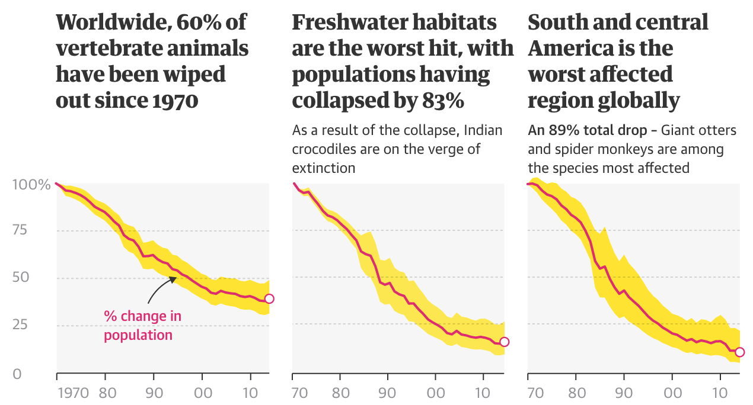
SUSTAINABILITY
Meeting the needs of the present without compromising the ability of future generations to meet their needs
Source: Living Planet index, WWF/ZSL

Slide 4
Environmental Impact
Energy Production, Distribution, Utilization
Greenhouse gases (CO2, CH4)
Air quality issues (NOx, SOx, PM, HC)
Flora / fauna
Soil health
Aquatic ecosystem impact
Community health
Core issues understood, but not necessarily appreciated

Slide 5
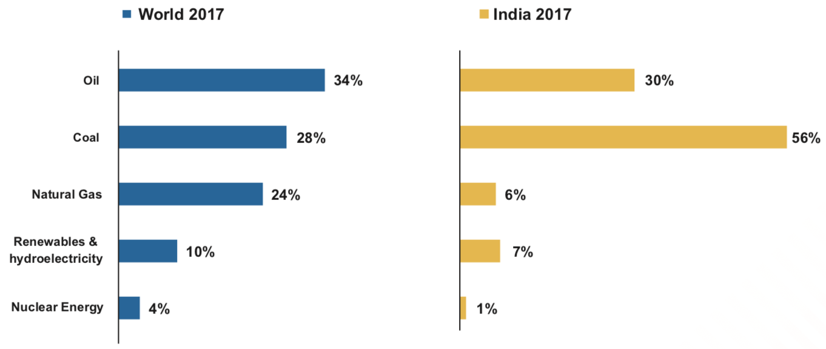
Primary Energy Mix
Source: BP Statistical review of world energy 2018
India’s oil demand is projected to grow at 4% CAGR till 2030
We have committed to reduce carbon intensity of GDP by 30-33%
Our dependence on fossil fuels is not changing fast enough

Slide 6
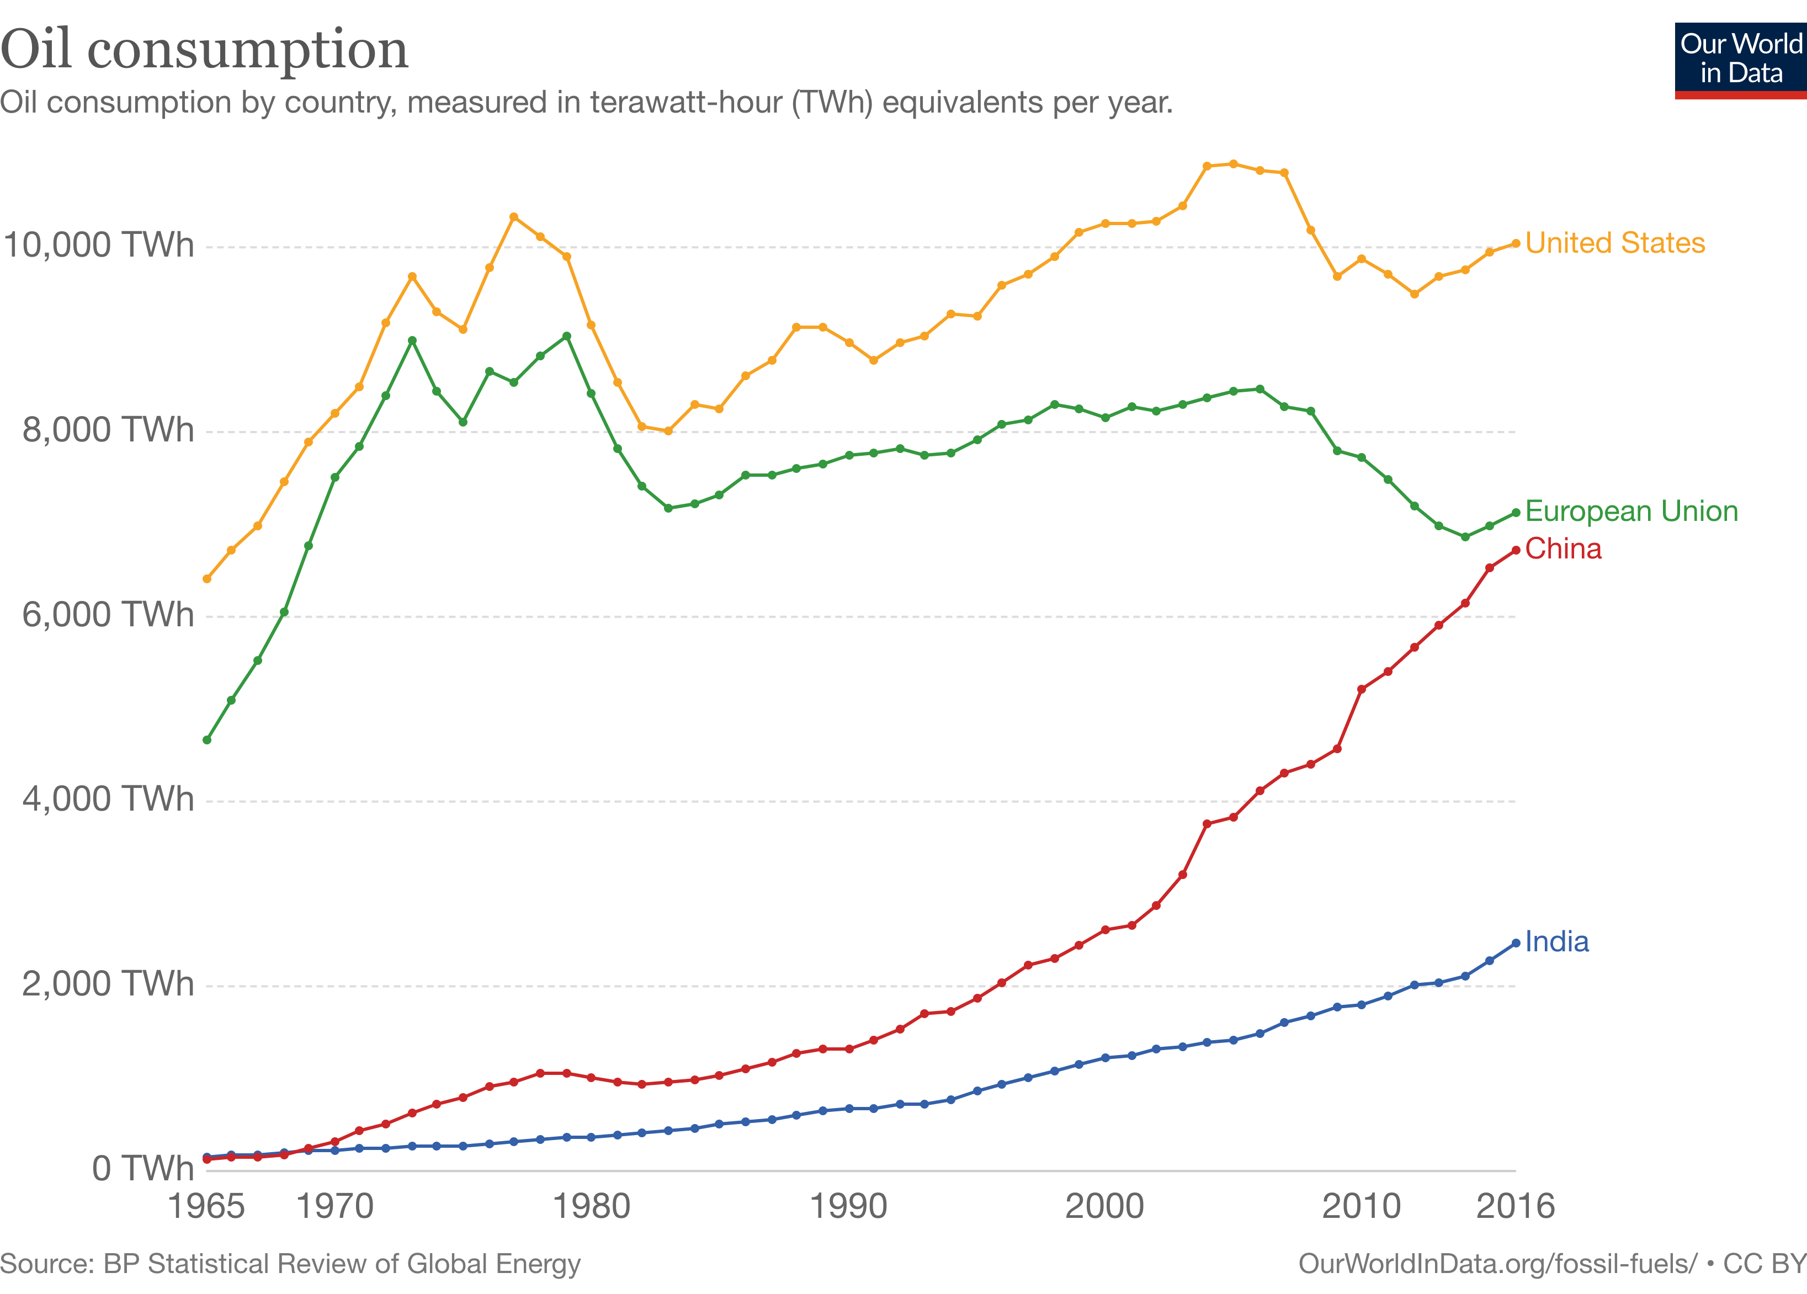
Petroleum is not going away…
Yet players along the value chain struggle with margins

Slide 7
India – Carbon Imports (approx)
Commodity | Import, MMT/yr | % C | Imported C, MMT/yr
Crude Oil | 220 | 85% | 190
Coal | 200 | 75% | 150
Natural Gas | 15 | 77% | 11.6
Demand Side Response
Reduce energy requirement (enhance efficiency)
Reduce carbon requirement (non-carbon energy e.g. solar, wind, geothermal)
Supply Side Response
Find about 350 MMT of domestic carbon (on current basis) to replace our fuel carbon imports
Need energy security solutions within our control

Slide 8
Carbon Localization
5-7 percent of the energy equivalent of crude processed in an oil refinery is consumed in refinery processes
Crude oil and its products are moved across billions of barrel-km per year, creating their own massive resource footprints
Increasing exploration of unconventional fuels (CBM, Shale, UCG, Tar Sands) linked to complex geodynamic processes and phenomena
Why must we over-consume and move so much carbon around?

Slide 9
Domestic Carbon Sources (estimates)
India – Second most populous nation ~18% of World population
Population growth and rapid urbanization drive increased MSW
Land limitations in India constrain availability of landfill space and supply-demand economics of urban land planning
Waste carbon sources abound – collection mechanisms are key
Commodity | Scope, MMT/yr | % C, approx | Potential C, MT/yr
Agri-residue (surplus) | 120 | 40% | 48
Forest residue | 150 | 42% | 63
Bio-gas (sewage, animal husbandry, dairy etc) | 800 | 45% | 360
MSW | 40 | 25% | 10
UCO | 5 | 85% | 4
~500 MMT of waste carbon excluding CO/CO2 emissions
All the carbon we need is available within our borders

Slide 10
Supply-Side Solutions
INCUMBENT | REPLACEMENT | TECHNOLOGY | CHALLENGES
Diesel | Biodiesel, Green Diesel, Bio-based alcohols and Ethers | Esterification, Hydroprocessing, Fermentation, Syngas-derived | Scalable Feedstock Supply
Gasoline | Bio-based alcohols and ethers, green gasoline | F-T, Fermentation, Alcohol-to-gasoline, Hydroprocessing, Pyrolysis/FCC, Catalytic Pyrolysis Bio-coking | Handling and blending infrastructure, feedstock variation
Aviation Fuel | Drop-in Bio-jet | Hydroprocessing, Sugar conversion, alcohol-to-jet, F-T | Scalable Feedstock Supply
CNG / PNG | Bio-CNG/Bio-PNG, HCNG, Bio-H2 | Fermentation | Purification, Supply chains
Low-sulfur Bunker Fuel | Green heavy distillate, biomass-derived oils | Hydroprocessing, Pyrolysis/FCC, HTL, MSW-thermochemical processing | Economic value relative to alternatives
Centralized (Existing Refining Infrastructure) or
Decentralized (Hub-and-Spoke) Models?

Slide 11
Scaling Up Biofuels
Lipids to bio-diesel and bio-jet fuel
Sugars to alcohols
Bio-gas to CBG / Bio-PNG
Lignocellulosic biomass to oxygenates and hydrocarbons
Community wastes (MSW / Septage) to fuels
Waste plastic to fuels and petrochemicals
Industrial emissions (CO / CO2 / CH4) to fuels and chemicals

Slide 12
Indian Standards on Petroleum fuels
Liquid fuels specifications
IS 1459:2018 Kerosene IS 1460:2017
Automotive Diesel Fuel
IS 1593:2018 Fuel Oils
IS 2796:2017 Motor Gasoline
IS 11489:1985 Heavy Petroleum stock (HPS)
IS 15770:2008 Light Diesel Oil
IS 16861 : 2018 High Flash High Speed Diesel Fuel
IS 1571:2017 Aviation Turbine Fuel, Kerosene type
Also: Methanol / methanol blends, alcohol ethers….
Source: Bureau of Indian Standards

Slide 13
Biodiesel
IS 15607 : 2016 Biodiesel B100 - Fatty Acid Methyl Esters (FAME)
Can be used as both blend component in IS 1460 HSD fuel and as a standalone fuel
Can be used for automotive, heating and industrial fuel applications
Raw material not restricted, but edible oils not permitted
IS 1460:2017 Automotive Diesel Fuel includes provision for blending up to 7% biodiesel
Large-scale production well established – but issues persist in supply chain and trade economics

Slide 14
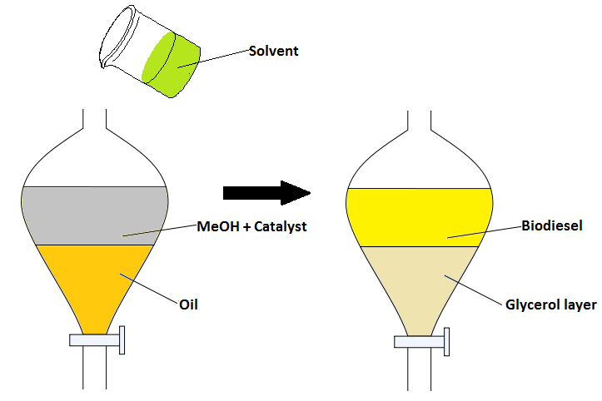
CSIR- IIP Room Temperature Biodiesel Process
Ambient catalytic conditions
No heating or mechanical stirring
After separation of glycerine, FAME biodiesel purified by water wash/distillation.
Especially suitable for small scale distributed operations
Can be used as distributed sourcing for bio-jet/HVO plants
“Drop and drive” rural community model enabled

Slide 15
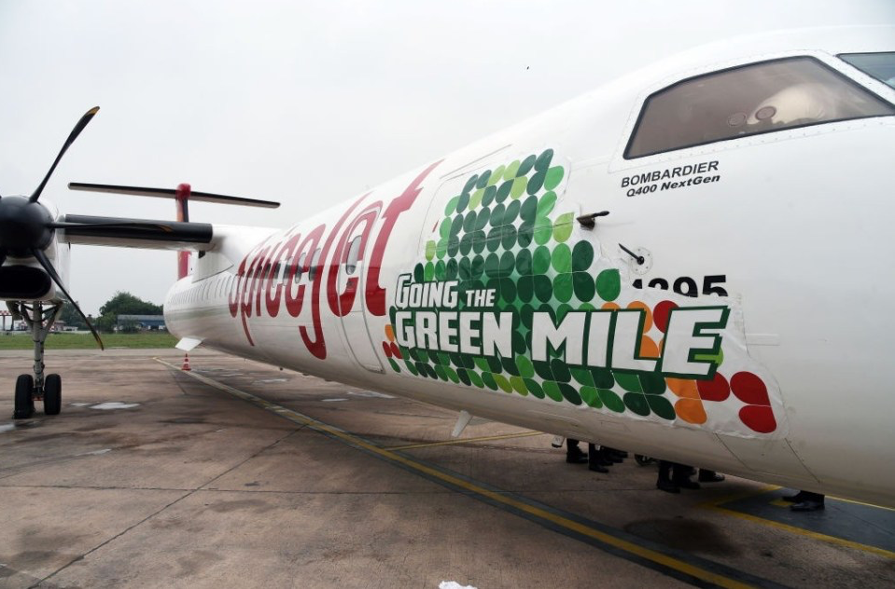
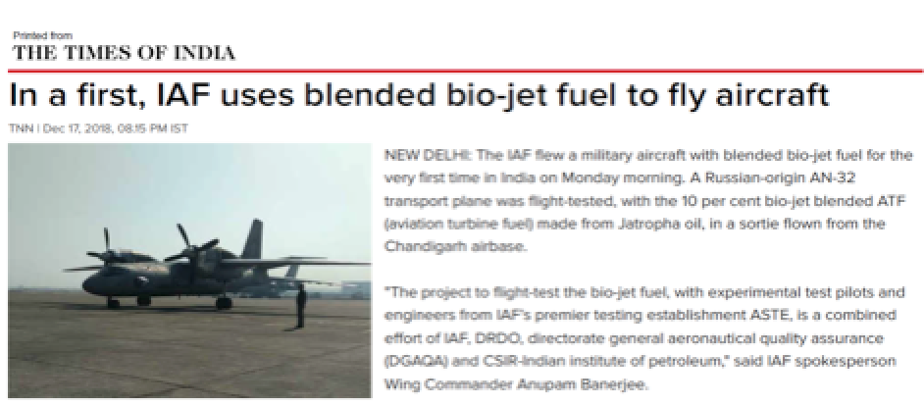
Civilian Flight
Bombardier Q400
Operated by SpiceJet
Dehradun-Delhi
27 August 2018
Military Flights
Antonov-32
Indian Air Force
Republic Day Parade
26 January 2019

Slide 16
Hype vs Reality “We can easily blend biodiesel up to 20%”
To build a minimum economic scale bio-jet plant, we require ~100 tons per day of TBO / rotation crop / algal oil
Oilseeds (Seed cake/pods/pruning assumed at Rs 3/kg)
What guarantees of supply would be provided?
What would be the long term contracted price for the oil?
How much land is to be planted? In how many years would one reach this output?
Algae (non-oil biomass value assumed at Rs 20 per kg)
What guarantees of supply would be provided?
What would be the long term contracted price for the oil?
How large a pond or coastal lagoon is required?

Slide 17
Scalable options for lipids
Today: ONLY Food value chain by-products
Used Cooking Oil
Palm Stearin
Fats oils from slaughterhouses, poultry, fisheries
EMERGING
Tree borne oils (regional TBOs, not just jatropha)
Rotation crops (carinata success story in Punjab)
FUTURISTIC
Microbial oils
Dairy and sewage fats

Slide 18
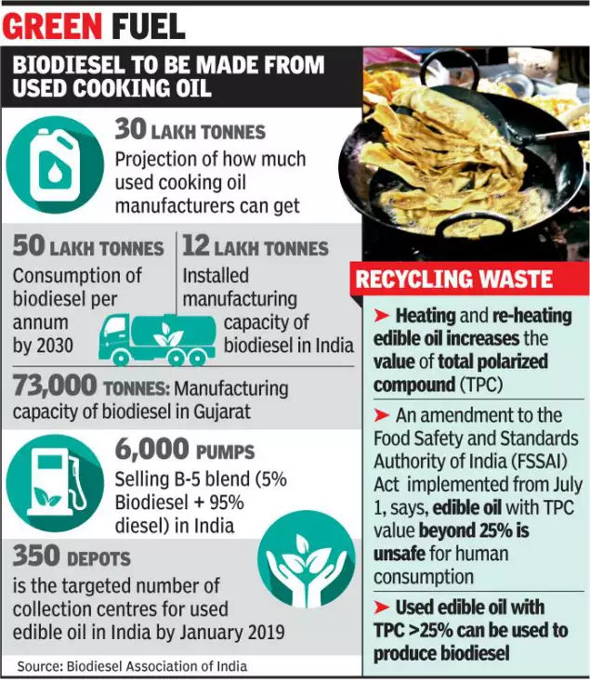
Used Cooking Oil based Biodiesel Now Commands a Premium

Slide 19
Adulteration in UCO-derived Biodiesel
Earlier, UCO was used to adulterate fresh edible oil
The RUCO initiative mandates diversion of UCO for biofuels production
Oil marketing companies pay a premium for UCO-based biodiesel relative to other biodiesel
This creates an opportunity for unscrupulous sellers to use inexpensive oils (acid oil, palm stearin, tallow) instead of UCO – so UCO, once an adulterant, is itself prone to adulteration!

Slide 20
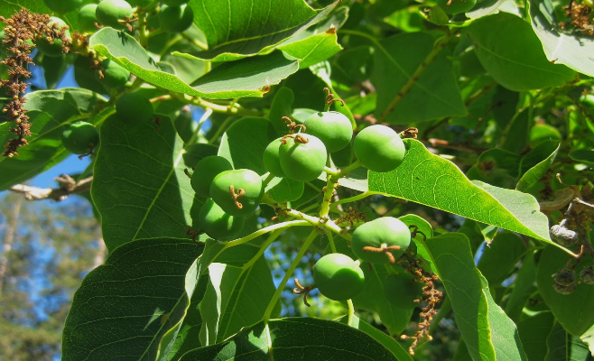
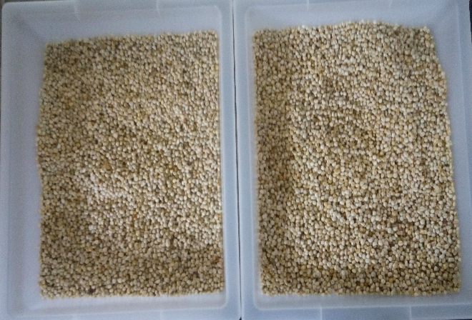
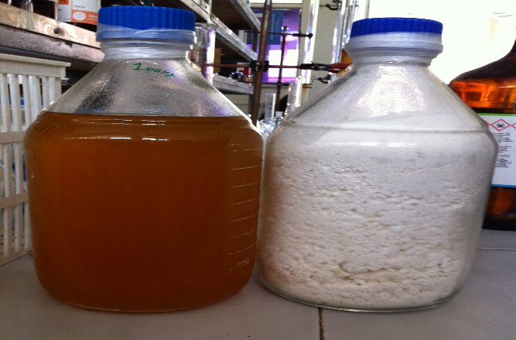
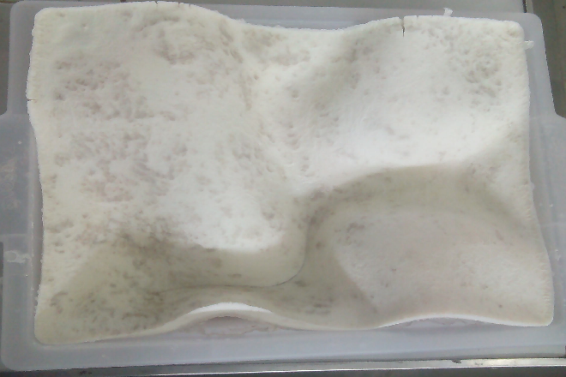
Beyond Jatropha: 100+ regional alternatives e.g. sapium
CSIR - Institute of Himalayan Bioresource Technology, Palampur
Biofuels
Valuable Wax

Slide 21
Oleaginous Yeast Lipids
Plant based oil production requires 6 months
yeast based oil production requires 80 hours

Slide 22
Carbon economies for oil production from oleaginous yeasts
Maximum theoretical conversion
100 g glucose 33 g Tri- Acyl Glycerol (TAG)
(Ratledge, 2014.)
Highest practical conversion
100 g glucose 17-20g TAG
Most microbes are not able to obtain maximum theoretical yield due to diversion of flux towards other metabolites.
Tuning the carbon flux to improve the lipid production by genetic engineering in oleaginous yeast Rhodotorula sp. RMIIPL32
Using C5 sugars – by product of biomass-based (2G) ethanol units
Biomass yield 0.268 g/g of xylose consumed
Lipid yield 0.17 g/g of xylose consumed
Fat coefficient of 17.54% w/w on consumed sugar basis

Slide 23
Fatty acid composition of SCO from RMIIPL32
# | Fatty acid | Short-hand designation | %(w/w)
1 | Capric Acid | C10:0 | 4.76
2 | Lauric Acid | C12:0 | 6.31
3 | Myristic Acid | C14:0 | 5.76
4 | Palmitic Acid | C16:0 | 19.75
5 | Stearic Acid | C18:0 | 2.76
6 | Oleic Acid | C18:1 | 48.69
7 | Linoleic Acid | C18:2 | 4.74
 | Total Saturated fat |  | 40.88
 | Total Mono unsaturated fat |  | 48.92
 | Total Polyunsaturated fat |  | 4.99

Slide 24
In Conclusion...
Biofuels have taken much longer than anticipated to fulfill their promise
Scalability has been the primary constraint
Increased focus on deployment, coupled with rigorous reality checks, helps enhance chances of successfu projects
A concerted effort along the value chain, supported by conducive policies (e.g. SATAT for bio-CNG), is making a visible difference

Slide 25
Thank You
Great Backyard Bird Count, 2018
64 bird species
World Environment Day, 2017
90+ butterfly and moth species

