Slide 1

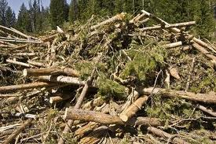
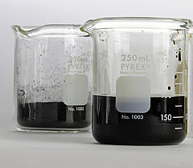
Hydrodeoxygenation of fast pyrolysis oil over Pd/Al₂O₃ catalyst
VIMAL KUMAR, Department of Chemical Engineering , IIT Roorkee, India
B. Prasad, Department of Chemical Engineering, IIT Roorkee, India
D. V. Naik, M.O. Garg, CSIR-Indian Institute of Petroleum, Dehradun, India
Lovraj Kumar Memorial Trust (LKMT) R&D Meet
July 24–25, 2015: IIChE NRC, New Delhi

Slide 2
Outline of the presentation
Introduction
Hydrodeoxygenation of FPO?
Experimental setup
Results and discussion
Conclusions

Slide 3
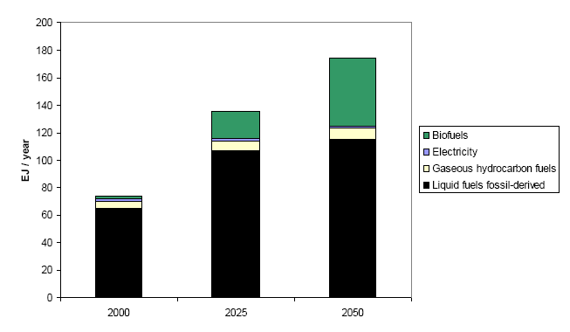
Worldwide energy scenario
The worldwide consumption of liquid fuels is bound to increase from 87 to 97 million barrels per day from 2010 to 2020, respectively and it is projected to 115 million barrels per day in 2040 [John et al. 2013]
Source: Shell energy scenario to 2050 (shell international BV, 2008)
Notes:
EJ= Exajoules=1.0E+18

Slide 4
India’s national policy on bio-fuels
First generation bio-fuels
  A target of 20% blending of biofuels, both for bio-diesel and bio-ethanol, by 2017 is proposed.
Second generation bio-fuels
  Not yet proposed
Source: http://mnre.gov.in/file-manager/UserFiles/biofuel_policy.pdf
Notes:
EJ= Exajoules=1.0E+18

Slide 5
General Budget 2015-16
The Ministry of New and Renewable Energy has revised its target of renewable energy capacity to 1,75,000 MW till 2022, comprising
  1,00,000 MW Solar,
  60,000 MW Wind,
  10,000 MW Biomass and
  5,000 MW Small Hydro
Source: http://pib.nic.in/budget2015/budgetdoc/gbEngRelease.pdf
Notes:
EJ= Exajoules=1.0E+18

Slide 6

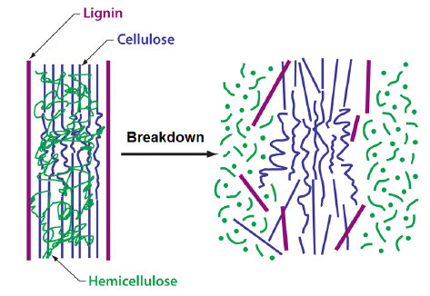

Second generation biofuels
The conversion of lignocellulosic biomass into hydrocarbons addresses
Clean energy
Sustainability
Environment issues

Slide 7
Pyrolysis techniques
Techniques | Residence Time | Heating Rate | Temp (°C) | Products
Carbonization | Days | Very Low | 400 | Charcoal
Conventional | 5-30 min | Low | 600 | Oil, gas, char
Fast | 0.5-5 sec | Very High | 650 | Bio-oil
Flash-liquid | <1 sec | High | <650 | Bio-oil
Flash-gas | <1 sec | High | <650 | Chemicals, gas
Ultra | <0.5 | Very High | 1000 | Chemicals, gas
Vacuum | 2-30 sec | Medium | 400 | Bio-oil
Hydro-pyrolysis | <10 sec | High | <500 | Bio-oil
Methano-pyrolysis | <10 sec | High | >700 | Chemicals

Slide 8
Fast pyrolysis reactors development status
Reactor | Technology | Owned by | Capacity, TPD* | Construction, Year | Application
Auger | ABRI-Tech | ABRI-Tech | 50.0 | 2008 | Energy
Ablative | BTO® | Pytec, Germany | 6.0 | 2005 | CHP#
Bubbling fluid bed | BioThermTM | Dynamotive, Canada | 200 | 2007 | Energy
Circulating fluid bed | Ensyn/RTPTM | Ensyn, Canada | 75 | 2007 | CHP#
Rotating cone | BTG-BTL | Empyro BV, Netherlands | 120 | 2012 | CHP#
*TPD: Tons per day #CHP: Combined heat and power

Slide 9
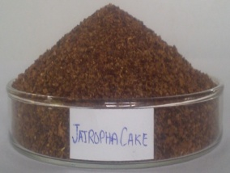
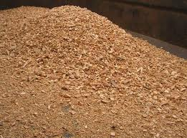
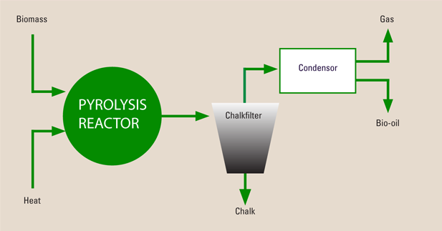
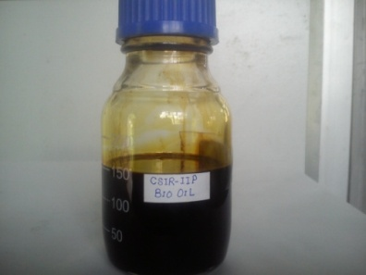
Fast pyrolysis
“Rapid thermal decomposition of organic material in an oxygen-free environment”
Operating principles
  Short residence time < 2 sec
  Higher heating rate > 1000 ºC/s
  Moderate temperature 400-550ºC
  Moisture content <10%
  Quick separation of char particles
  Rapid quenching of pyrolysis vapors
Salient Features
  Higher conversion ~ 85-90%
  Maximum liquid yield ~ 60-75 wt.%
  Qualitative bio-char yield ~ 10-15 wt.%

Slide 10

Fast pyrolysis reactors development status [Venderbosch et al. 2010]
Reactor | Technology | Owned by | Capacity, TPD* | Construction, Year | Application
Auger | ABRI-Tech | ABRI-Tech | 50.0 | 2008 | Energy
Ablative | BTO® | Pytec, Germany | 6.0 | 2005 | CHP#
Bubbling fluid bed | BioThermTM | Dynamotive, Canada | 200 | 2007 | Energy
Circulating fluid bed | Ensyn/RTPTM | Ensyn, Canada | 75 | 2007 | CHP#
Rotating cone | BTG-BTL | Empyro BV, Netherlands | 120 | 2012 | CHP#
*TPD: Tons per day #CHP: Combined heat and power

Slide 11
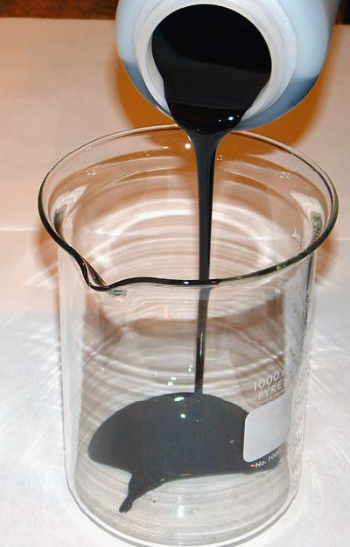
Fast pyrolysis oil properties, challenges
Fast pyrolysis oil properties
Not miscible with fossil hydrocarbons
Not distillable
Highly oxygenated (H/C_{eff} < 0.5)
Highly corrosive (pH: 2 - 4)
High water content (15-35 wt.%)
Lower heating value (16-19 MJ/kg)
Fast pyrolysis oil challenges
Unstable due to ageing (polymerization of oxy compounds)
Competitive pricing to fossil hydrocarbons

Slide 12
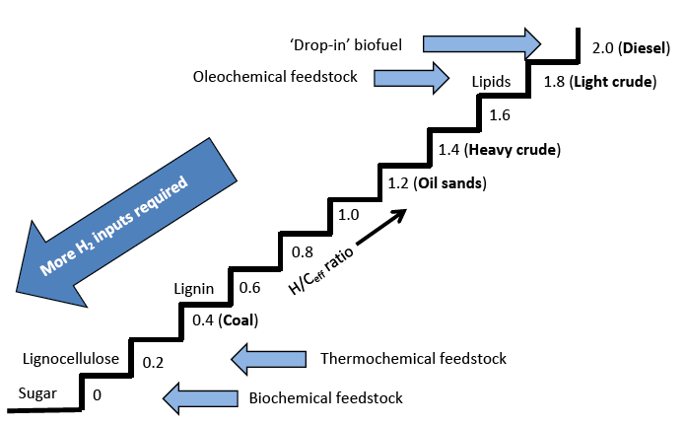
Effective Hydrogen-to-Carbon Ratio

Slide 13
Modification of chemical composition
Techniques for stabilization of FPO
In-process (gas phase)
Post-process (liquid phase)
Catalytic pyrolysis
  Catalytic-mixing
  Catalytic bed
  Co-catalytic
Process parameters
  Rector configuration
  Temperature
  Pressure
  Environment
  Layout
Thermal treatment
Hydrothermal treatment
High pressure thermal treatment
Catalytic emulsion
Catalytic hydrogenation

Slide 14
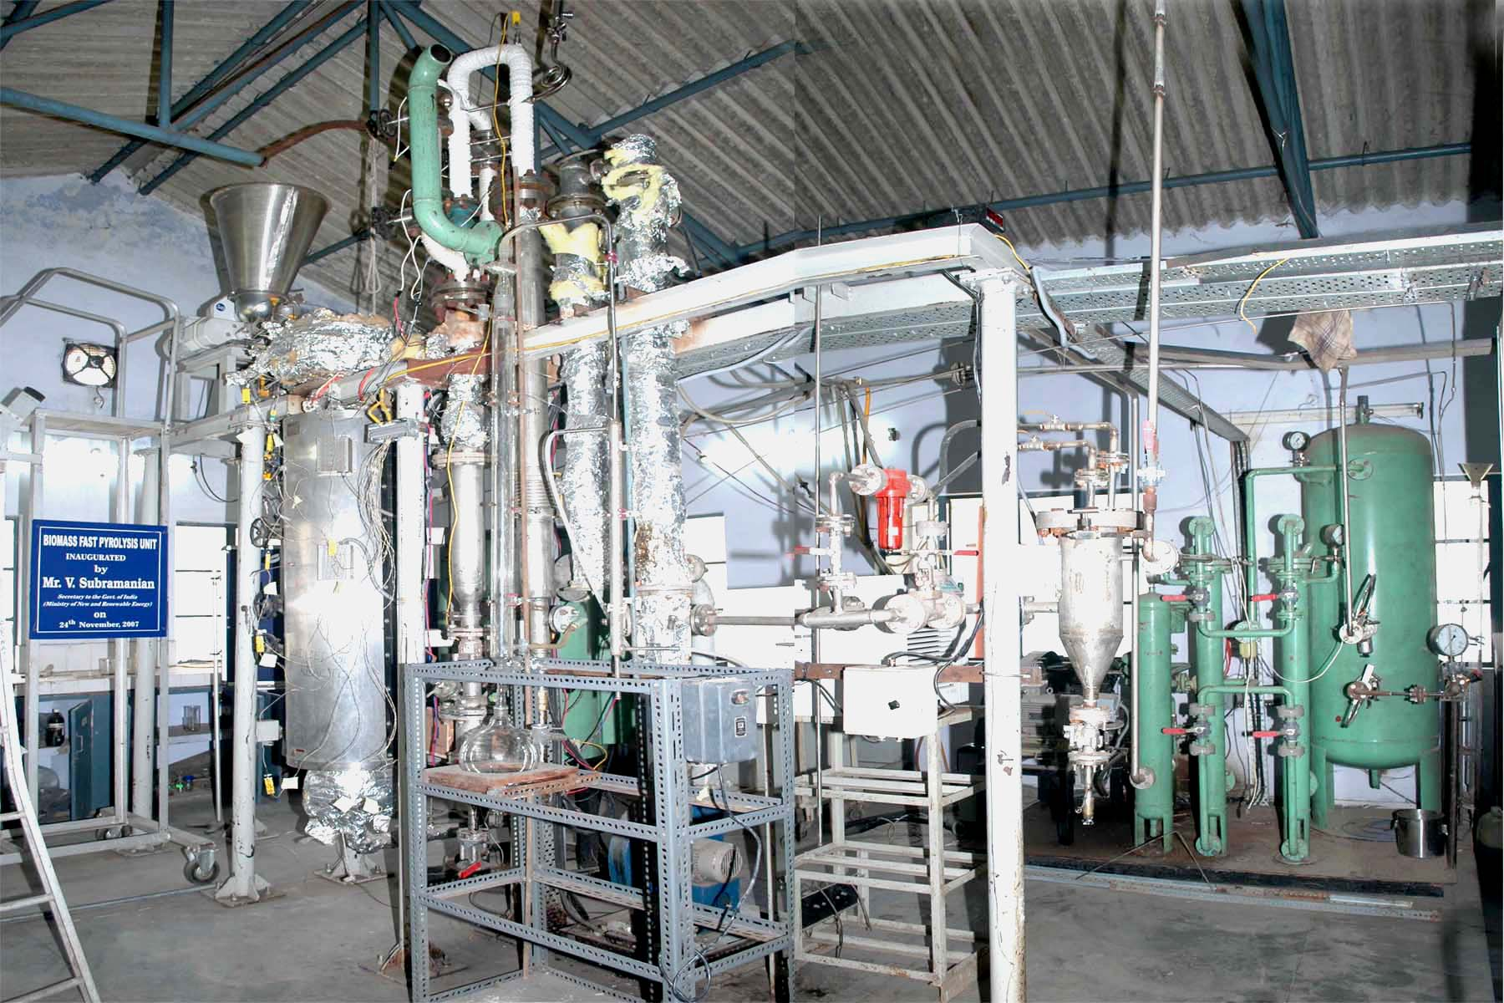
Fast pyrolysis unit
Salient features:
Capacity: 3 kg/h
Reactor: Bubbling fluidized bed
Heating media: Sand
Biomass: Jatopha expelled cake (particle size: ≈1.4 mm)
Temperature: 530 °C
Pressure: 1 atmosphere
FPO unit at IIP Dehradun

Slide 15
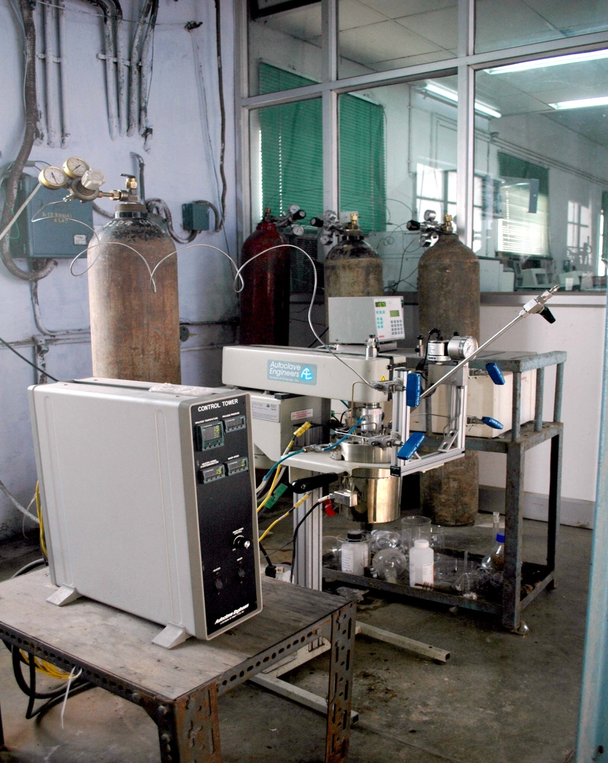
Autoclave reactor: Hydrodeoxygenation of FPO
Salient features:
Capacity: 600 ml
Feed: Crude pyrolysis oil
Catalyst: Pd/Al₂O₃ catalysts
Reactor: CSTR (Batch)
Temperature: 250-300 °C
Pressure: 80 bar

Slide 16
Catalyst Preparation
Palladium (99.9%, Sigma-Aldrich Chemicals) and γ-alumina Al₂O₃ (97%, Sigma-Aldrich Chemicals) were chosen as an active and support materials for the preparation of hydrodeoxygenating catalyst.
Mesoporous alumina was prepared using incipient wetness impregnation method.
  The Pd was loaded over alumina.
  1.0 g of Palladium (II) nitrate dihydrate was dissolved in 30 ml of water, and 20 ml of ethanol and 20 g of γ-alumina (Al₂O₃) (Surface area = 243 m² g⁻¹) was added simultaneously.
  The mixture was stirred constantly at 80 °C for 5 hours to dry the sample.
  The dried sample was further dried at 120 °C for overnight in an oven. Finally, the Pd metal loaded on alumina was calcined at 500 °C in a furnace for 8 h to prepare Pd/Al₂O₃ catalyst (2% Pd on alumina).

Slide 17
Hydrodeoxygenation of FPO
A 100 ml stainless steel, high pressure stirred tank reactor (M/s Autoclave Engineers, USA) with bolted closure, floor stand and magnetic drive assembly was used to partially hydrodeoxygenate the heavy fraction of FPO in batch mode.
Before starting the reaction, the reactor was purged with hydrogen gas for a period of 5 min, and then it was pressurized up to 80 bar pressure.
A constant speed of stirrer was maintained at 700 rpm.
The reactor temperature was raised to 250 ⁰C/300 ⁰C from ambient with heating rate of 5 ⁰C min⁻¹.
As a result an increase in reactor pressure was observed from 80 to 120 bars.
The same temperature was maintained for a period of 4 h.
The reactor was then cooled down to ambient temperature.
The liquid products were collected and analyzed separately using NMR spectroscopy.

Slide 18
Elemental analysis:
Biomass Feedstock, FPO and HDO
Sample name | C, wt.% | H, wt.% | N, wt.% | O, wt.% | S, wt.% | H/C | O/C
Jatropha curcas cake | 45.50 | 6.70 | 2.43 | 45.33 | 0.04 | 1.76 | 0.74
Fast pyrolysis oil | 56.50 | 7.10 | 4.30 | 32.0 | 0.09 | 1.50 | 0.42
HDO oil at 250 °C | 64.98 | 8.0 | 4.91 | 22.0 | 0.11 | 1.50 | 0.25
HDO oil at 300 °C | 76.18 | 8.8 | 4.91 | 10.0 | 0.11 | 1.40 | 0.09

Slide 19
Van Krevelen Diagram:
Biomass Feedstock, FPO and HDO oils

Slide 20
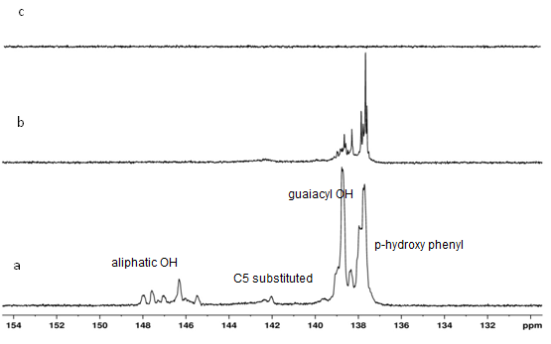
³¹P NMR Characterization of (a) FPO; (b) HDO at 250 °C; and (c) HDO at 300 °C

Slide 21
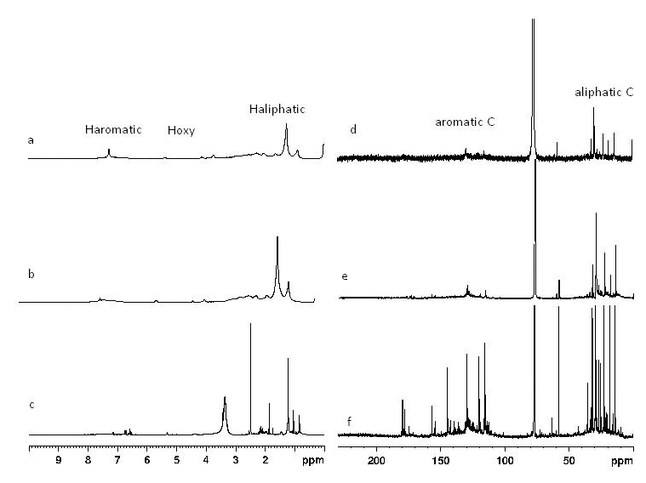
(a) ¹H NMR of HDO at 300 °C, (b) ¹H NMR of HDO at 250 °C, (c) ¹H NMR of FPO, (d) ¹³C NMR of HDO at 300 °C, (e) ¹³C NMR of HDO at 250 °C, (f) ¹³C NMR of FPO

Slide 22
Hydroxyl Group Contents of FPO and HDO Determined by quantitative ³¹P NMR
Sr. No. | Functional group | Integration region, ppm |  | FPO | HDO oil, 250 °C | HDO oil, 300 °C
 |  | Ben et al. 2013 | Present study
1 | Aliphatic OH | 150.0 to 145.5 | 150.02 to 145.07 | 2.37 | 0.27 | Nil
2 | C5 substituted β-5 | 144.7 to 142.8 | 145.07 to 140.42 | 1.23 | 0.6 | Nil
3 | Guaiacyl phenolic OH | 140.0 to 139.0 | 140.42 to 138.2 | 6.2 | 1.51 | Nil
4 | p-hydroxy-phenyl OH | 138.2 to 137.3 | 138.2 to 136.96 | 5.75 | 1.89 | Nil
Derivatization with 2-chloro-4, 4, 5, 5-tetramethyl-1, 3, 2-dioxaphospholane (TMDP)

Slide 23
A selectivity data for co-processing of FPO and HDO with VGO
Feedstock’s | VGO:FPO |  |  |  | VGO:HDO | VGO | VGO:FPO
Blending ratio | 95:5 | 90:10 | 85:15 | 80:20 | 95:5 | 100 | 83:17
FCC conversion, % | 75.68 | 74.69 | 69.35 | 64.39 | 66.96 | 66.89 | 66.08
Yield, wt.%
Dry gas (C1-C2) , wt.% | 2.182 | 2.05 | 1.43 | 1.41 | 1.507 | 1.798 | 1.42
LPG (C3-C4), wt.% | 38.876 | 35.70 | 28.69 | 23.77 | 28.78 | 15.5 | 25.44
Gasoline (C5-216°C), wt.% | 29.038 | 31.14 | 35.11 | 35.04 | 32.50 | 44.02 | 35.08
LCO (216-370°C), wt.% | 14.885 | 15.43 | 17.99 | 20.49 | 18.98 | 19.84 | 19.11
HCO(>370°C), wt.% | 8.054 | 8.48 | 10.67 | 14.08 | 13.27 | 12.4 | 12.31
Coke, wt.% | 5.48 | 5.21 | 4.23 | 4.16 | 4.17 | 5.58 | 4.14
[Naik et al., RSC Advances, 5, 398-409, 2015]

Slide 24
Conclusions
Hydroxyl and mono lignol groups were eliminated during hydrodeoxygenation.
HDO oil obtained at 300 °C can be used along with VGO as a co-processing feedstock for processing in a refinery FCC unit.
The trillion dollars of petroleum refinery infrastructure and their existing distribution network can be effectively utilized.

Slide 25
Acknowledgements
All co-authors
Special thanks to Indian Institute of Technology Roorkee and
CSIR-Indian Institute of Petroleum for their technical and
financial support.

Slide 26



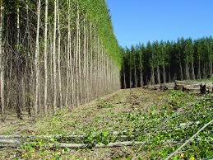
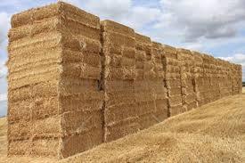
Thank you very much for your kind attention

Slide 27
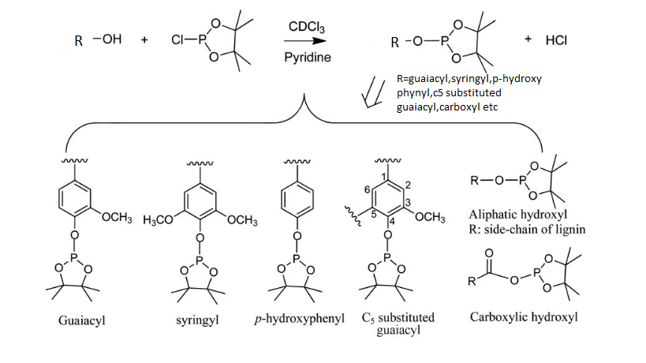
Reaction scheme for derivatized ³¹P NMR

Slide 28
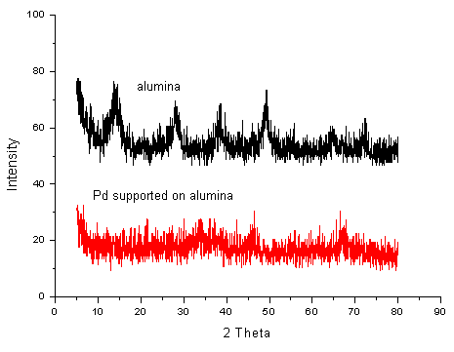
Catalyst Characterization
XRD patterns of the mesoporous alumina (black colour) and Pd supported on mesoporous alumina (red colour)
N₂ adsorption-desorption isotherm

Slide 29
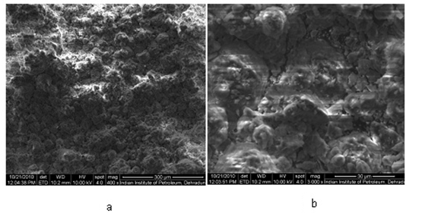
Catalyst Characterization: SEM monograms
Mesoporous alumina
Pd supported mesoporous alumina

Slide 30
Bubbling fluidized bed reactor
Features:
Heat supplied externally to bed
Good heat & mass transfer
Easy scale up
Well understood technology
Small particle size needed (< 2mm)
Heat transfer to bed at large scale has to be proven

Slide 31
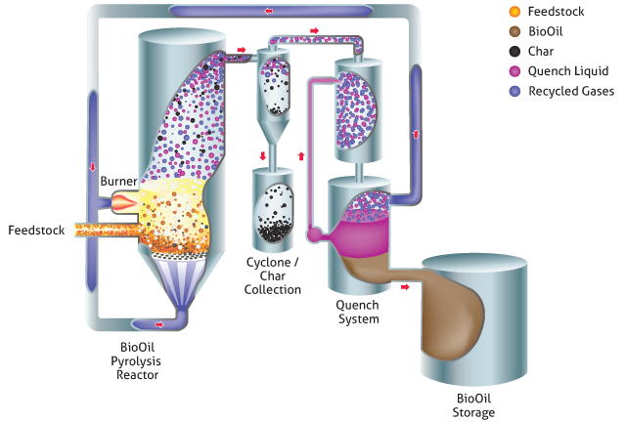
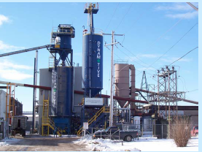
Dynamotive energy systems
Process Scheme
4 T/hr Demonstration Plant

