Slide 1

INSTITUTE OF CHEMICAL TECHNOLOGY
MUMBAI
Study of RWGS reaction over supported Al₂O₃ catalysts
Suhas G. Jadhav, Prakash D. Vaidya
LKMT R&D Meet – 2015
Department of Chemical Engineering
July 24 – 25, 2015, New Delhi

Slide 2
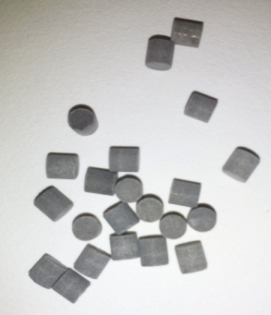
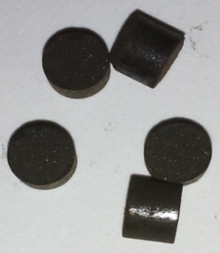
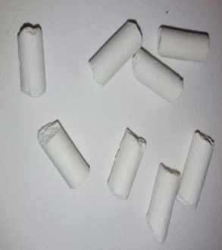
INSTITUTE OF CHEMICAL TECHNOLOGY
MUMBAI
OVERVIEW
Motivation
Objectives
Experimental methods
Results and discussion
Summary and outlook
CO₂ + H₂
CO + H₂O
Vaidya LKMT R&D Meet

Slide 3
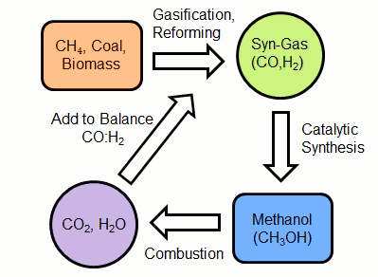
INSTITUTE OF CHEMICAL TECHNOLOGY
MUMBAI
MOTIVATION
The demand for methanol is ever-growing!
Dimethyl ether
Formaldehyde
Acetic acid
MTBE
Others
Fuels
MTO, MTG
Vaidya LKMT R&D Meet

Slide 4
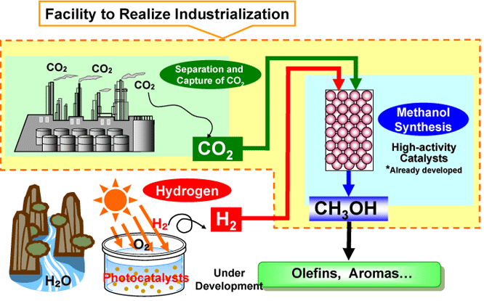

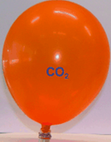

INSTITUTE OF CHEMICAL TECHNOLOGY
MUMBAI
MOTIVATION
Methanol production from CO₂ and H₂ is attractive!
www.mitsuichem.com
Lurgi AG, Sud-Chemie, H-T, Mitsui Chemicals and Carbon Recycling International have provided solutions
Vaidya LKMT R&D Meet

Slide 5
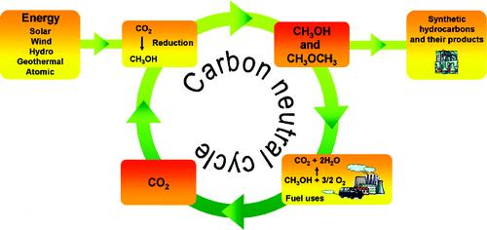
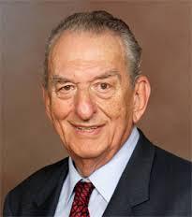
INSTITUTE OF CHEMICAL TECHNOLOGY
MUMBAI
MOTIVATION
Methanol economy for a sustainable future
George Olah
Chemical recycling of CO₂
Vaidya LKMT R&D Meet

Slide 6
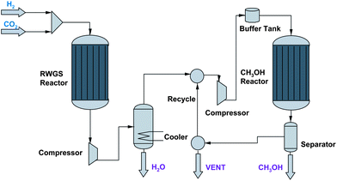
INSTITUTE OF CHEMICAL TECHNOLOGY
MUMBAI
MOTIVATION
CAMERE – An alternative methanol production process
ADVANTAGES
Low cost process
High MeOH productivity
Superior catalyst performance
Small reactor size
Low recycle streams
Mitigates Greenhouse gas effect
Better than one-step process
CArbon dioxide to MEthanol via REverse water gas shift
Vaidya LKMT R&D Meet

Slide 7
INSTITUTE OF CHEMICAL TECHNOLOGY
MUMBAI
OBJECTIVES
To study reaction mechanism of RWGS over the catalysts
CuO/ZnO/Al₂O₃
ZnO/Al₂O₃
Pt/Al₂O₃
To propose kinetic models to aid the design and operation of RWG Reactor
To study plausible effects of mass transfer processes on rates of CO₂ conversion
To study the influence of reaction variables on catalyst performance
Vaidya LKMT R&D Meet

Slide 8
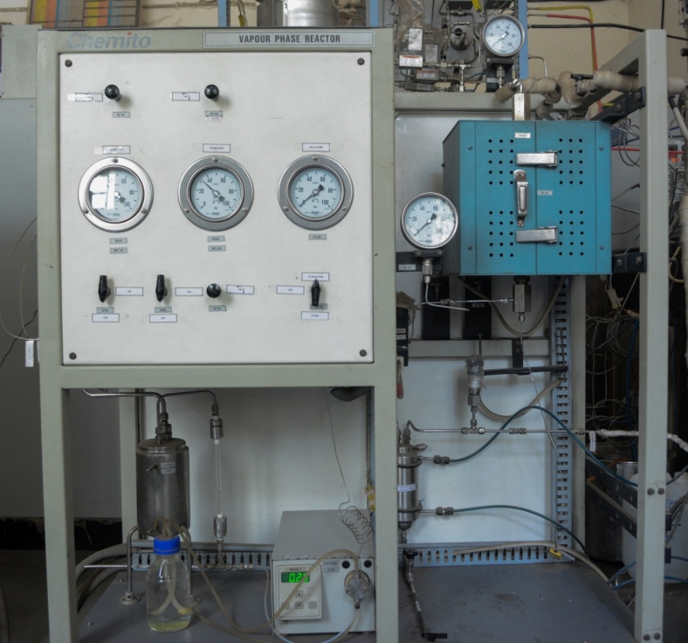
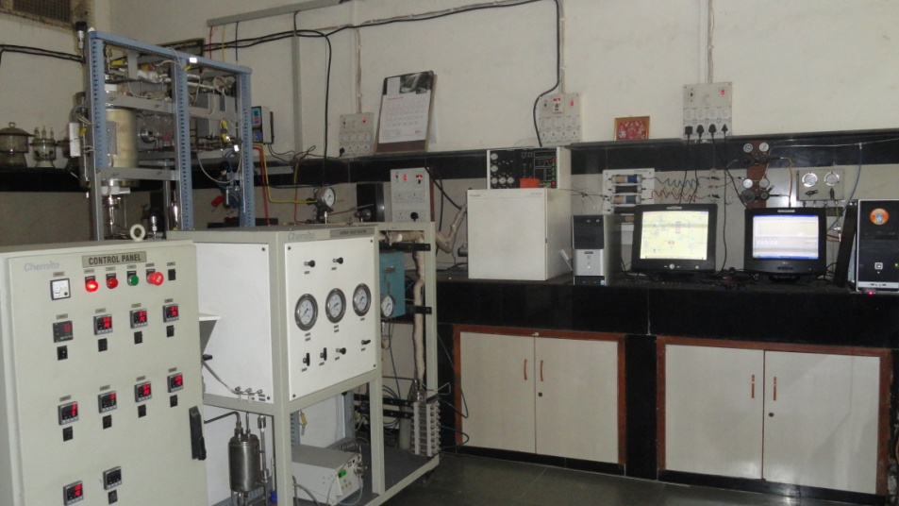
INSTITUTE OF CHEMICAL TECHNOLOGY
MUMBAI
EXPERIMENTAL METHODS
Vapor-phase catalytic reactor
Vaidya LKMT R&D Meet

Slide 9
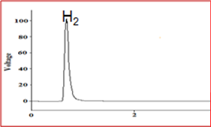
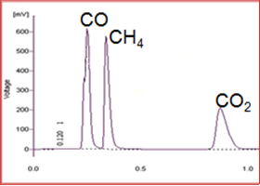
INSTITUTE OF CHEMICAL TECHNOLOGY
MUMBAI
EXPERIMENTAL METHODS
Gas chromatography analysis
 | H₂ analysis | CO_{X} analysis
Column | Hayesep-DB | Hayesep-DB
Detector | TCD | TCD
Carrier Gas | Nitrogen | Hydrogen
Vaidya LKMT R&D Meet

Slide 10
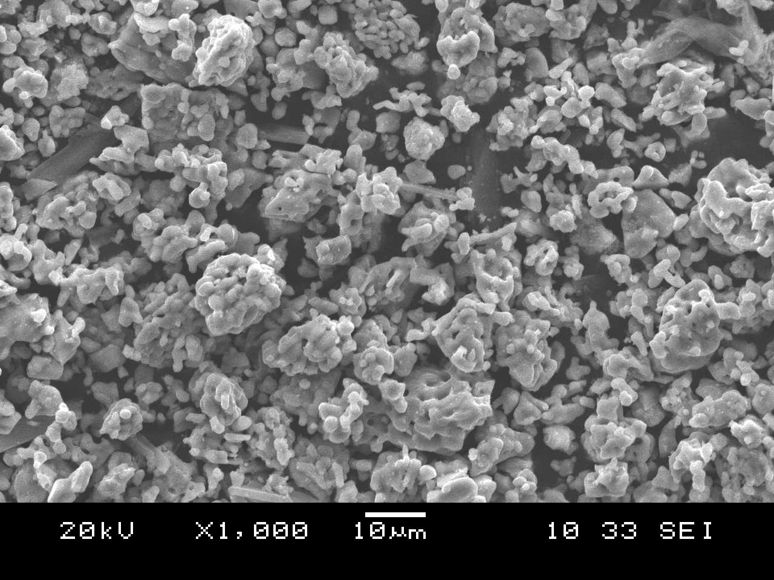
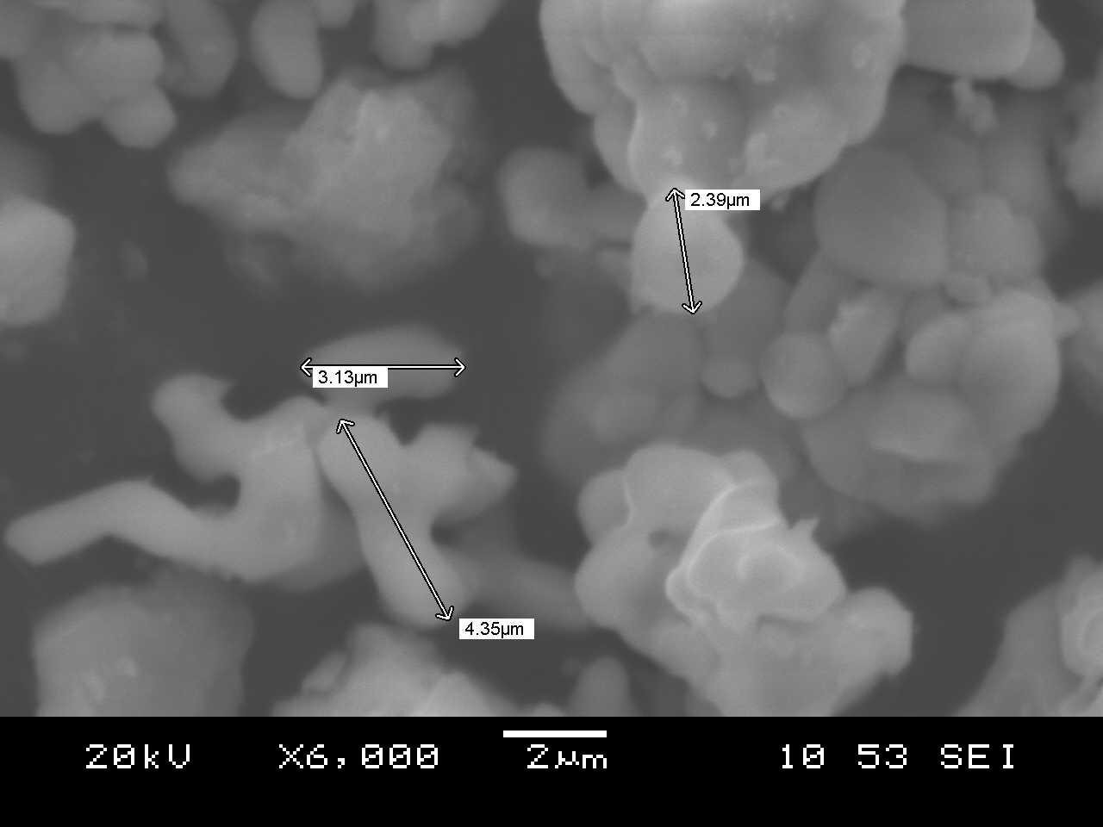
INSTITUTE OF CHEMICAL TECHNOLOGY
MUMBAI
EXPERIMENTAL METHODS
SEM photographs of Pt/Al₂O₃ catalyst
Vaidya LKMT R&D Meet

Slide 11
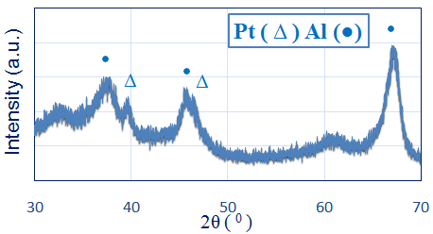
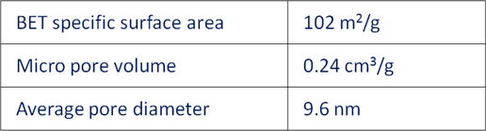
INSTITUTE OF CHEMICAL TECHNOLOGY
MUMBAI
EXPERIMENTAL METHODS
Useful features of Pt/Al₂O₃ catalyst
Vaidya LKMT R&D Meet

Slide 12
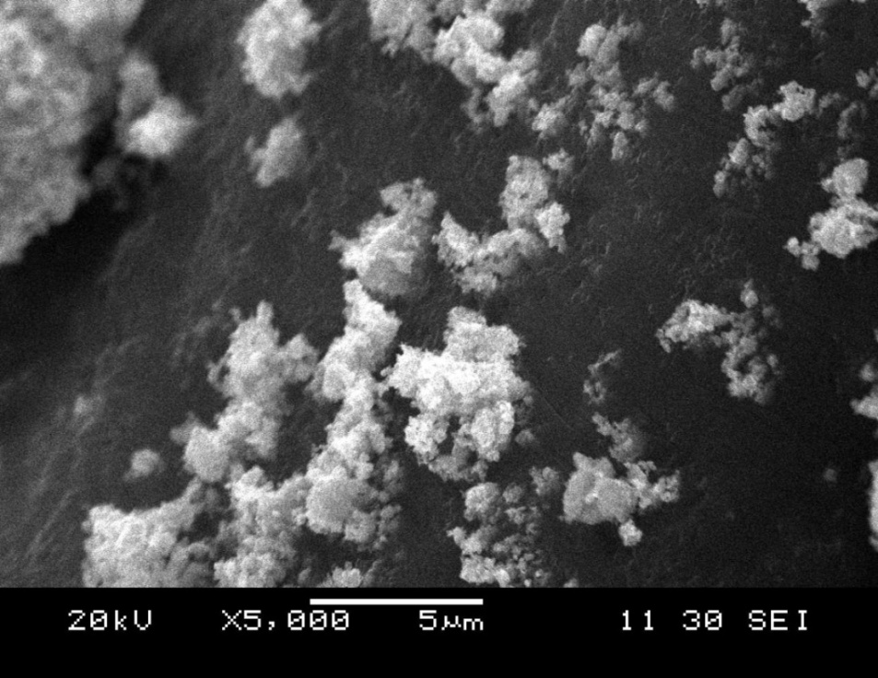
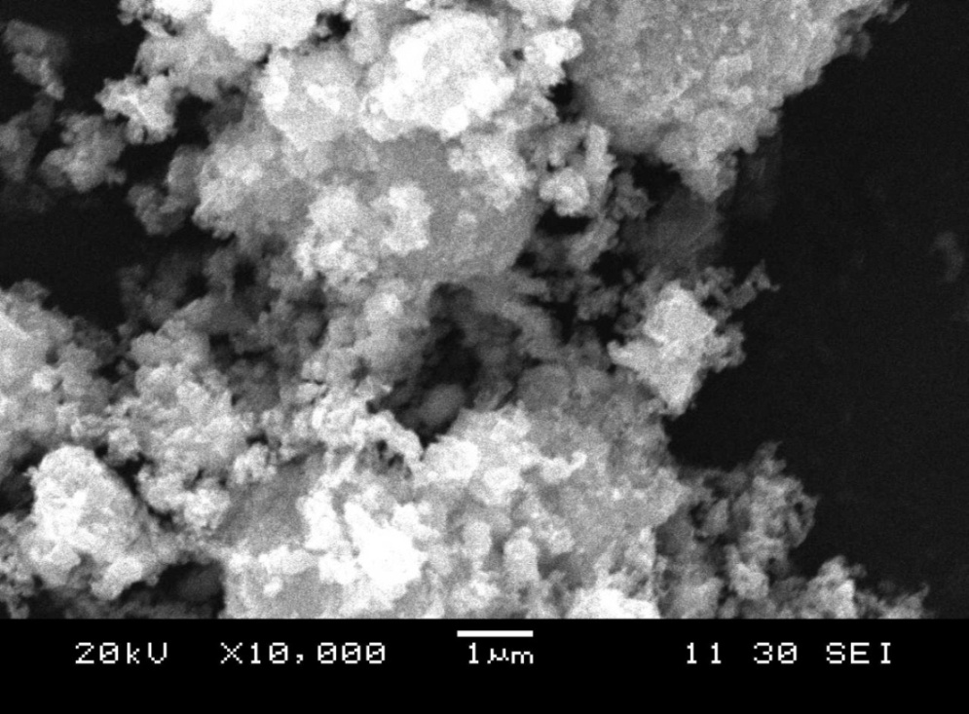
INSTITUTE OF CHEMICAL TECHNOLOGY
MUMBAI
EXPERIMENTAL METHODS
SEM photographs of ZnO/Al₂O₃ catalyst
Vaidya LKMT R&D Meet

Slide 13
INSTITUTE OF CHEMICAL TECHNOLOGY
MUMBAI
EXPERIMENTAL METHODS
XRD pattern of ZnO/Al₂O₃ catalyst
Vaidya LKMT R&D Meet

Slide 14
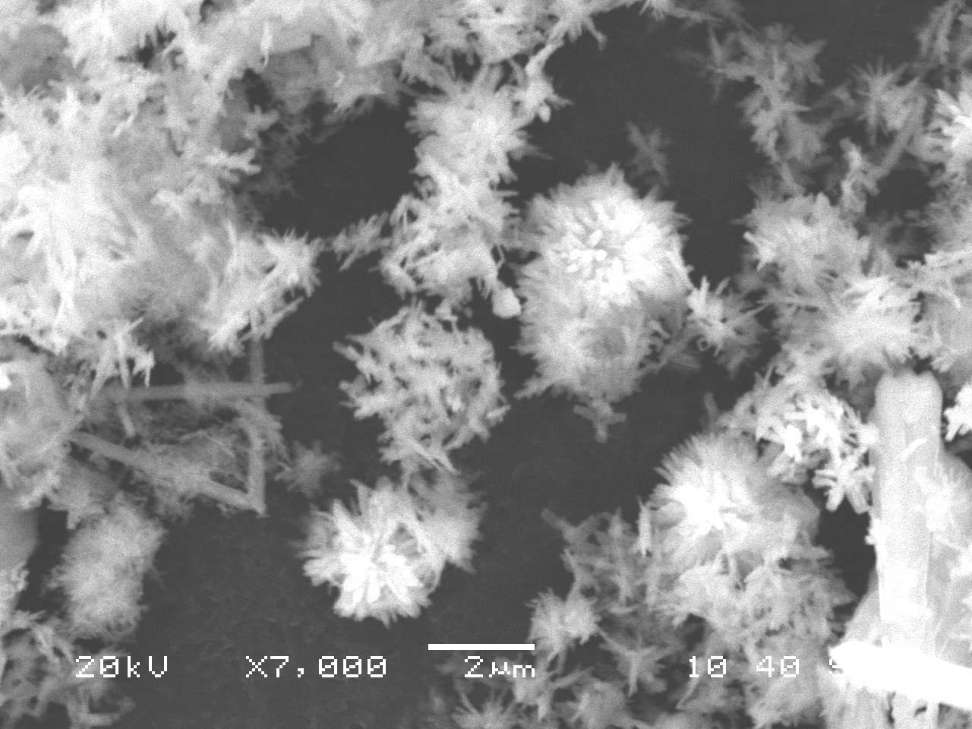
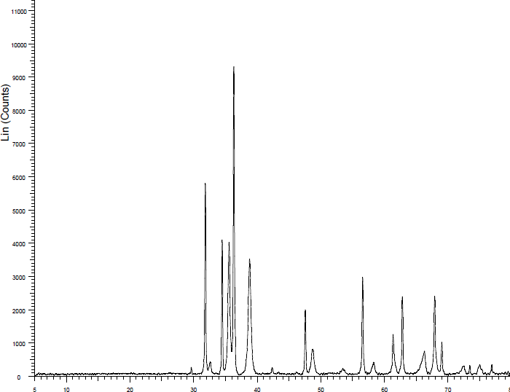
INSTITUTE OF CHEMICAL TECHNOLOGY
MUMBAI
EXPERIMENTAL METHODS
Properties of CuO/ZnO/Al₂O₃ catalyst
SEM photograph
XRD pattern
Vaidya LKMT R&D Meet

Slide 15
INSTITUTE OF CHEMICAL TECHNOLOGY
MUMBAI
RESULTS AND DISCUSSION
Activity trials with Pt/Al₂O₃
H₂/CO₂=1 mol/mol, P=0.1 MPa, F=0.7 mol/h,
T=873 K, W/Q₀=0.14 g h/L
H₂/CO₂=1 mol/mol, P=0.1 MPa, F=0.7 mol/h,
Q₀=36 L/h
Vaidya LKMT R&D Meet

Slide 16
INSTITUTE OF CHEMICAL TECHNOLOGY
MUMBAI
RESULTS AND DISCUSSION
Activity trials with Pt/Al₂O₃
H₂/CO₂=1 mol/mol, P=0.1 MPa, F=0.7 mol/h,
W/Q₀=0.25 g h/L
H₂/CO₂=1 mol/mol, F=0.7 mol/h,
W/Q₀=0.25 g h/L
Vaidya LKMT R&D Meet

Slide 17
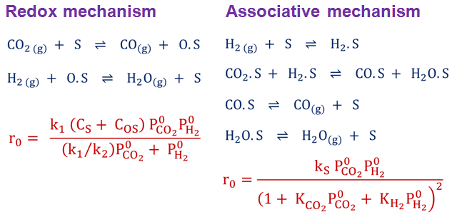
INSTITUTE OF CHEMICAL TECHNOLOGY
MUMBAI
RESULTS AND DISCUSSION
Kinetic model over Pt/Al₂O₃
P=0.1 MPa, F=0.7 mol/h,
CO₂=18 L/h
Vaidya LKMT R&D Meet

Slide 18
INSTITUTE OF CHEMICAL TECHNOLOGY
MUMBAI
RESULTS AND DISCUSSION
Activity trials with CuO/ZnO/Al₂O₃
H₂/CO₂=1 mol/mol, P=0.1 MPa, Q₀=23.3 L/h
H₂/CO₂=1 mol/mol, P=0.1 MPa, Q₀=23.3 L/h
Vaidya LKMT R&D Meet

Slide 19
INSTITUTE OF CHEMICAL TECHNOLOGY
MUMBAI
RESULTS AND DISCUSSION
Activity trials with ZnO/Al₂O₃
P (MPa) | H₂/CO₂ | GHSV (mL/g h) | Catalyst | Temp. (K) | X (%) | Ref
0.1 | 3 | 15000 | ZnO/Al₂O₃ | 673 773 873 973 | 8.0 37.0 58.0 68.0 | Park et al. (2001)
0.1 | 1 | 5143 | ZnO/Al₂O₃ | 673 773 873 973 | 12.3 31.4 42.7 53.7 | This work
Vaidya LKMT R&D Meet

Slide 20
INSTITUTE OF CHEMICAL TECHNOLOGY
MUMBAI
SUMMARY AND OUTLOOK
The two-step CAMERE process for CO₂-to-methanol conversion was considered
The performance of alumina-supported catalysts for RWGS reaction was studied
The effects of T, P and H₂/CO₂ ratio on conversion of CO₂ were investigated
The prevalence of the chemical control regime was established
Kinetic models were tested to describe the rates of CO₂ conversion
The redox mechanism was dominant over all the investigated catalysts
Vaidya LKMT R&D Meet

Slide 21
INSTITUTE OF CHEMICAL TECHNOLOGY
MUMBAI
Financial support by the University Grants Commission, India, is gratefully acknowledged.
Vaidya LKMT R&D Meet

Slide 22
INSTITUTE OF CHEMICAL TECHNOLOGY
MUMBAI
Thank you for your attention!
Vaidya LKMT R&D Meet

