Slide 1
Computational Modeling of Coal Gasification: Above & Underground Systems
Ankit A Jain, Akshay Singan and Vivek V Ranade
Chemical Engineering and Process Development Division
CSIR- National Chemical Laboratory,
Pune – 411008
vv.ranade@ncl.res.in

Slide 2
Outline
Coal gasification
  Indian Coal Scenario
  Gasification – Physical Picture – Overall Comparison – Applications and view of advantages and disadvantages
  Above and below ground systems/ role of computational modelling
Computational models
  Thermodynamic models
  CRE models
  CFD models
Summary and conclusions

Slide 3
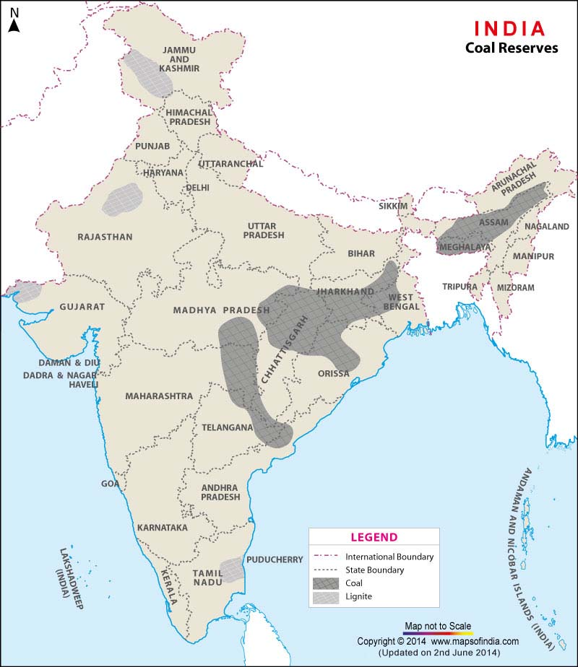
Indian Coal Scenario
Coal is primary source of energy ( >50 % of total energy consumption)
India: third largest producer of coal
Fourth largest coal reserves in world
Indian coal high in ash (15-45%) and low calorific value
Indian coal reserves:
  Eastern and central parts of peninsular India (bituminous and subbituminous)
  Southern and western parts of peninsular shield (lignite reserves)
Need to reduce the ever increasing import requirement of coal
Need to look for cleaner and greener coal technology solutions
http://www.mapsofindia.com/maps/india/coalreserves.htm

Slide 4
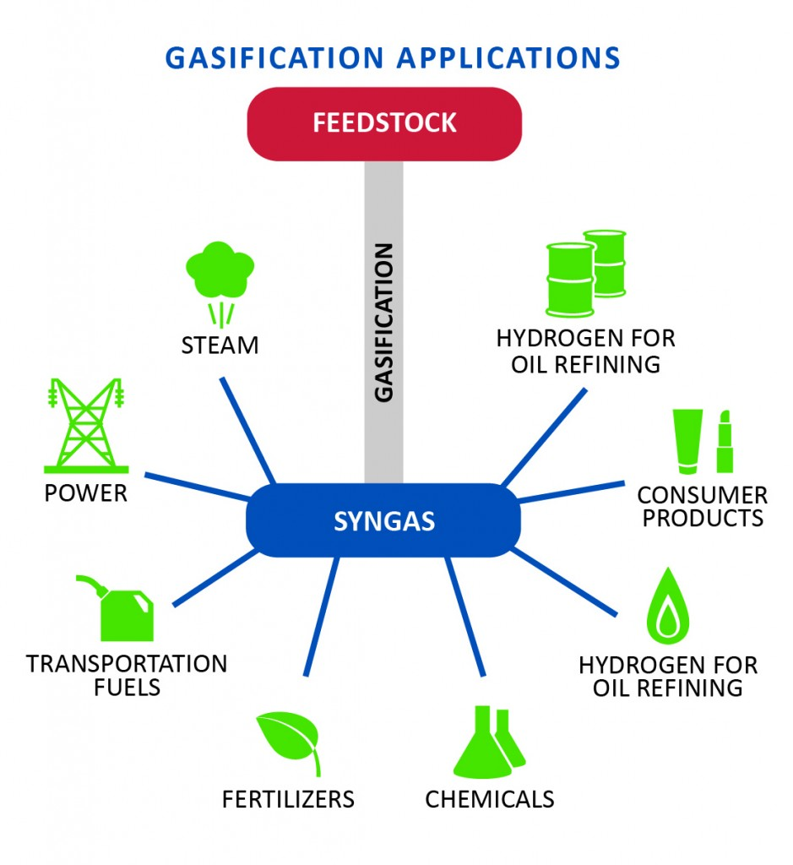
Gasification applications
Gasification is a partial oxidation process whereby a carbon source such as coal, natural gas or biomass in presence of steam is broken down primarily into carbon monoxide (CO) and hydrogen (H₂)
Syngas (CO +H2) produced can be used to produce electricity and a number of high value products such as chemicals, fertilizers, hydrogen, liquid fuels, etc.
Coal can be mined and gasified in a reactor (surface) or can be gasified in-situ (underground coal gasification)

Slide 5
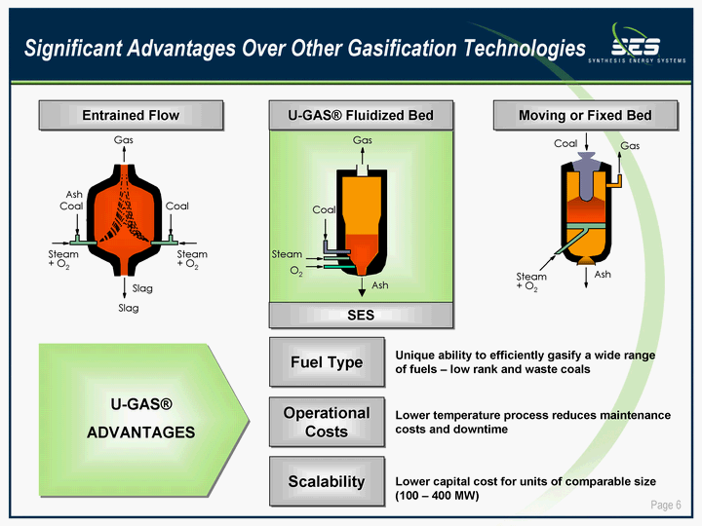
Surface gasification
Technologies
  Fixed/Moving bed gasifier: Sasol/Lurgi
  Entrained bed gasifier: GE, Udhe, Shell, MHI, Philips 66, Siemens
  Fluidized bed gasifier: Udhe, U-gas, KBR, Great point energy
All technologies have their advantages/ disadvantages
U-Gas (SES) fluidized bed gasifier capable of handling 50 % ash coal (2400 MTD of sub-bituminous gasifier commisioned at Yima, China 2013)
Entrained bed gasifier
Fluidized bed gasifier
Fixed bed gasifier

Slide 6
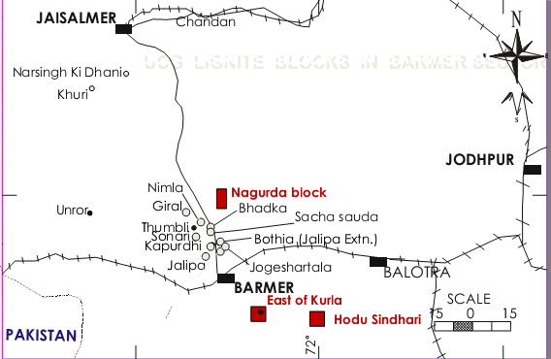
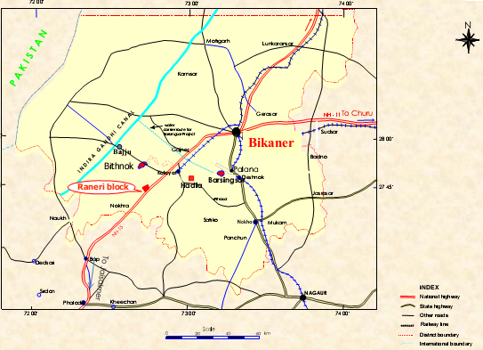
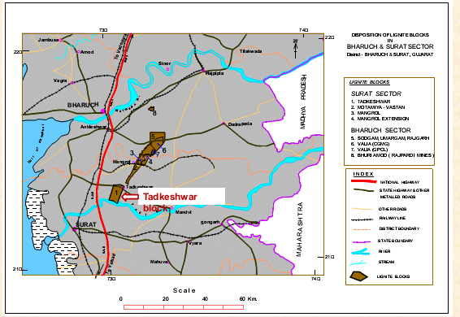
Underground coal gasification
Advantages
Possibility of 300 – 400 % increase in resource utilization
No Labour under dangerous conditions underground
No significant surface impact
Direct use of Synthesis gas with 50 % Less particulate emission and easier capture of No_{x} and So_{x}
Cheap and easy remediation of site post utilization along with effective coal utilization
Concerns
Managing ground water resources and preventing subsidence
Establish agile and modular facilities to ensure continuous end use of gas
Non steady state process – Cant be controlled as efficiently as surface gasification
Coal blocks reserved for UCG

Slide 7
Brief Comparison: Surface & UCG
Surface
UCG
Mining, transport, handling and treatment required
Cogeneration and flexibility in feedstock possible in the absence of coal – Facility for processing is common
Requires handling of Ash and pre-treatment of coal
Better Control
Requires a Gasifier
Coal is used directly at the point of availability
Only one fuel – Coal – Only cost – drilling, linking and gas handling
No need of pre-treatment of coal - Ash effects can be ignored
More Unknown and difficult to control
The seam surrounded by over and under burden is the gasifier

Slide 8
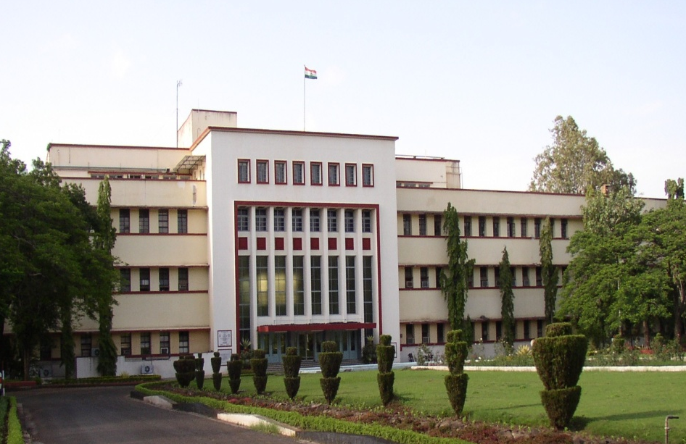
CSIR - National Chemical Laboratory
Industrial Flow Modeling Group (iFMG), NCL Pune
Led by Dr. VV Ranade (1990- till date)
Computational modeling of Industrial Flows (single and multiphase)
Reactor design and analysis of reactor operation
Process Intensification
  “To further knowledge in the chemical sciences and apply it for the benefit of the people.”

Slide 9

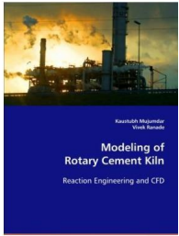
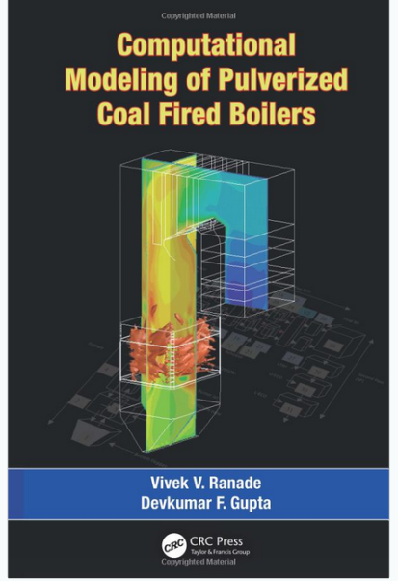
iFMg Experience
Analysing routes and processes for conversion of coal into energy and gas – Surface and Sub surface
Increasing the current state of knowledge through rigorous mathematical modeling and smart leverage of experiments to study complex processes involved in coal conversion
Interact with Industry and Other Academic institutions to aid and catalyze the the process from on paper understanding to field deployment

Slide 10
Modeling Approaches
Data Driven Models
  Regression Analysis
  Neural Networks
Thermodynamic Models
  Stoichiometric approach
  Non Stoichiometric approach
Rate based Models
  Chemical reaction engineering models
  Computational fluid dynamics models

Slide 11
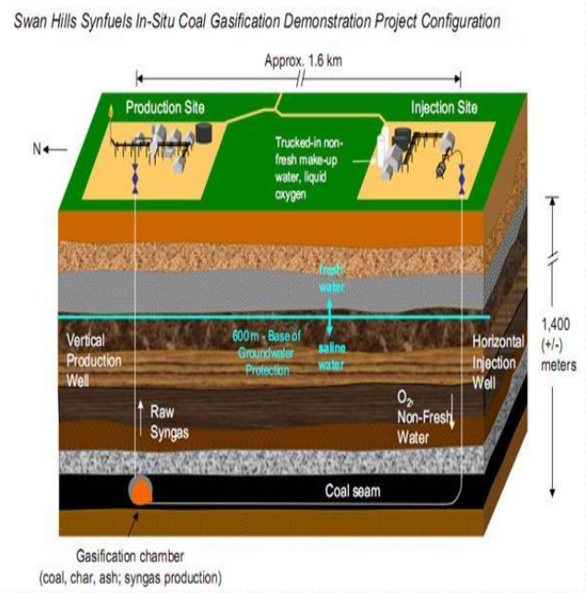
Physical Picture: BFBG and UCG
BFBG
UCG
Verma and Shafirovich (2008)

Slide 12
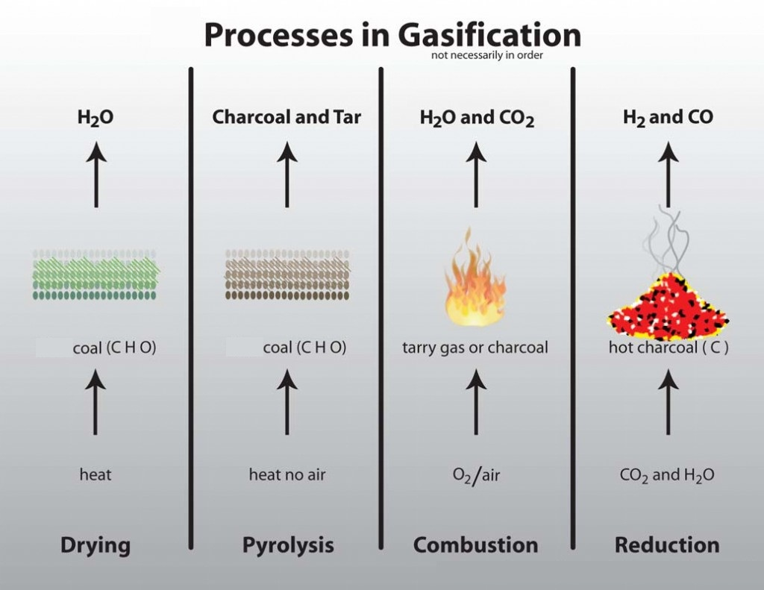
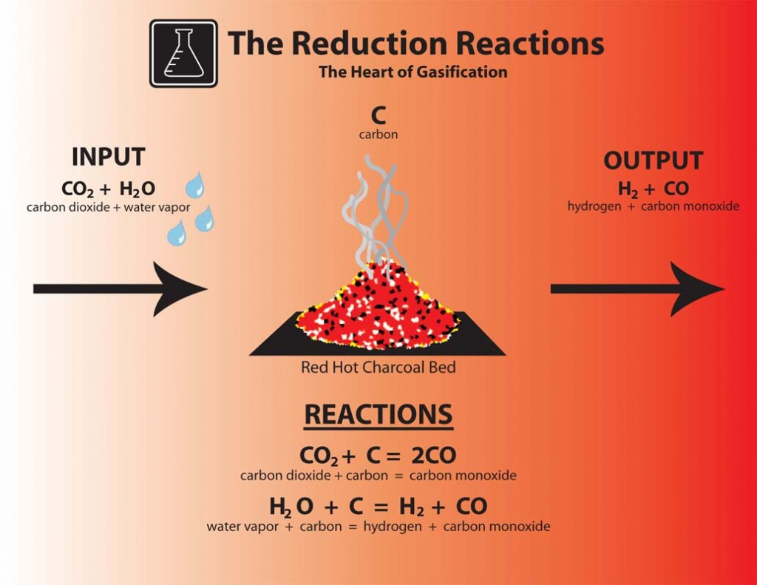
Gasification process
Four main Processes in Gasification
Heart of Gasification : Reduction reactions
*http://www.gekgasifier.com/info/gasification-basics/gasification-explained

Slide 13

Modeling Source Terms: TGA/DTF
TGA studies done to estimate kinetic model and parameters
Distributed activation energy model showed good match with experimental data

Slide 14
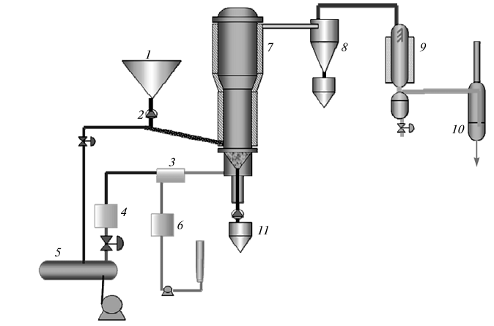
Experimental data: BFBG
All reported experimental investigations have reactor diameter between 0.1-0.2 m
Complete info. of commercial data BFBG not available
Trends identified with respect to operating parameters (P, T, Steam/ coal/Air/O₂ feed rate)
29 Experiments reported for high ash Indian coal identified for simulations
  18 experiments with Rajmahal coal and 11 experiments with North Karanpura (NK) coal
Parameters | Value
Reactor diameter | 0.2 m
Coal feed rate | 30-40 kg/s
Steam/coal | 0.2-0.6
Air/coal | 1.5-2.4 (Nm3/kg)
Bed temperature | 973-1173 K
Chavan, P. et al., 2012. Influence of high ash Indian coals in fluidized bed gasification under different operating conditions. Solid Fuel Chemistry, 46(2), pp.108–113.

Slide 15
Outline
Coal gasification
  Indian Coal Scenario
  Gasification – Physical Picture – Overall Comparison – Applications and view of advantages and disadvantages
  Above and below ground systems/ role of computational modelling
Computational models
  Thermodynamic models
  CRE models
  CFD models
Summary and conclusions

Slide 16
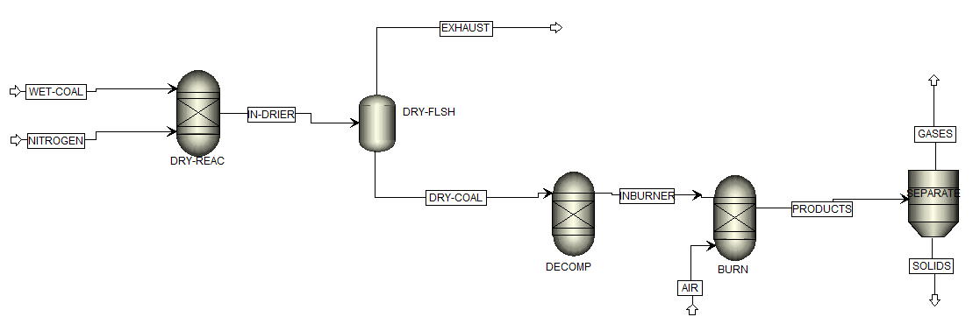
Thermodynamic analysis
RGIBBS module of Aspen Plus used to simulate BFBG
Model based on minimization of Gibbs free energy minimization approach using Lagrange multiplier method
Aspen Plus Model Flow sheet
Reproducing published results*
*Renganathan, T., Yadav, M. V., Pushpavanam, S., Voolapalli, R. K., & Cho, Y. S. (2012). CO2 utilization for gasification of carbonaceous feedstocks: A thermodynamic analysis. Chemical Engineering Science, 83, 159–170.

Slide 17
Results: thermodynamic analysis of BFBG
Parity plot comparing CGE of 18 experimental data sets of Rajmahal Coal with simulation results
Parity plot comparing CGE of 11 experimental data sets of NK Coal with simulation results
Simulations with complete C as inlet shows X = 100 % and over prediction of CGE
Simulations with carbon input = reported X shows under prediction
Trends match with experimental data

Slide 18
Model Equations
Gibbs free energy of the total mixture is calculated by summing up Gibbs free energy of a species over the different reactions
Functional form for Total Gibbs Energy that is minimized
Oxidation reaction
Water-Gas shift reaction
Boudouard Reaction
Steam Methanation Reaction
j- C, O₂, H₂, H₂0, CO, CO₂, CH₄, H₂

Slide 19
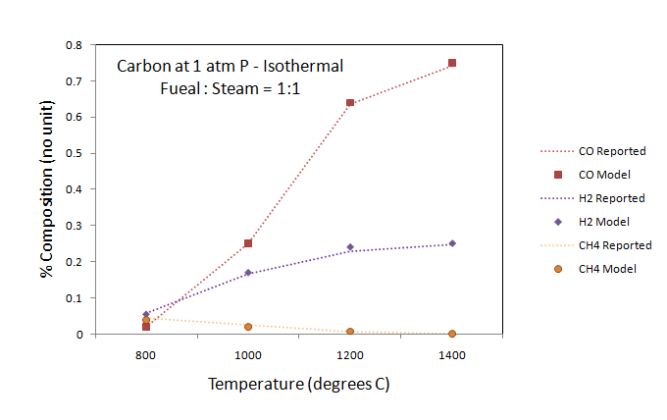
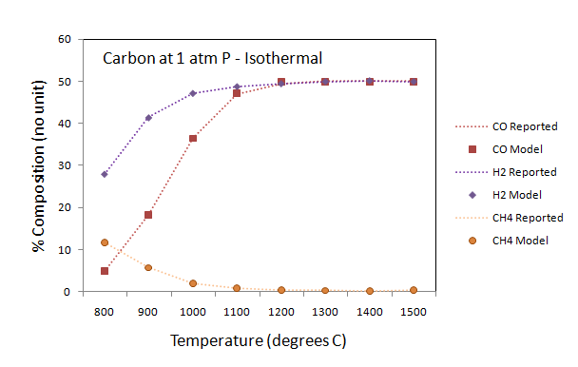
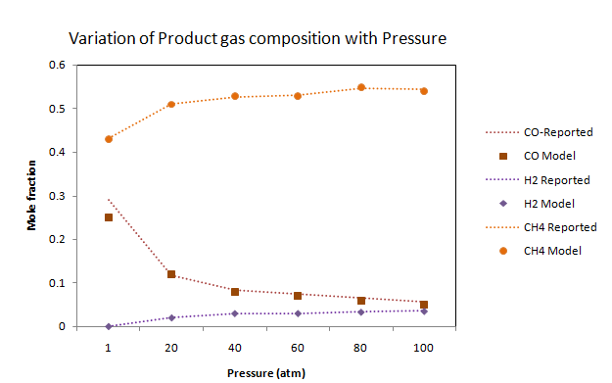
Model Validation: Base case
Perkins (2005)

Slide 20
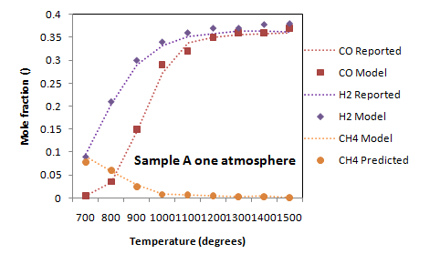
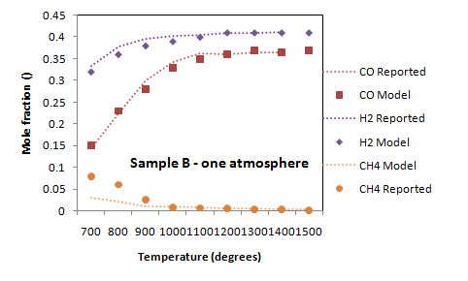
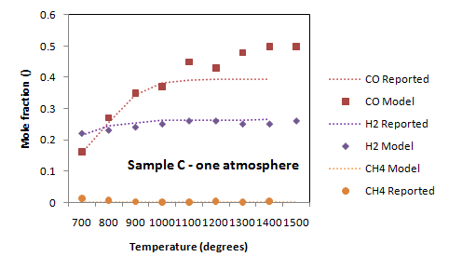
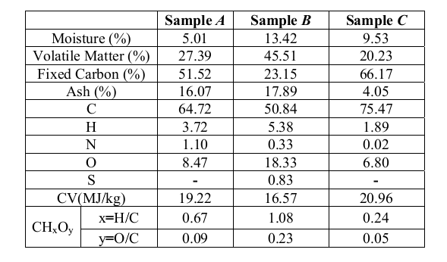
Simulated Results – Khadse et al. (‘07)
Khadse (2007)

Slide 21
Outline
Coal gasification
  Indian Coal Scenario
  Gasification – Physical Picture – Overall Comparison – Applications and view of advantages and disadvantages
  Above and below ground systems/ role of computational modelling
Computational models
  Thermodynamic models
  CRE models
  CFD models
Summary and conclusions

Slide 22
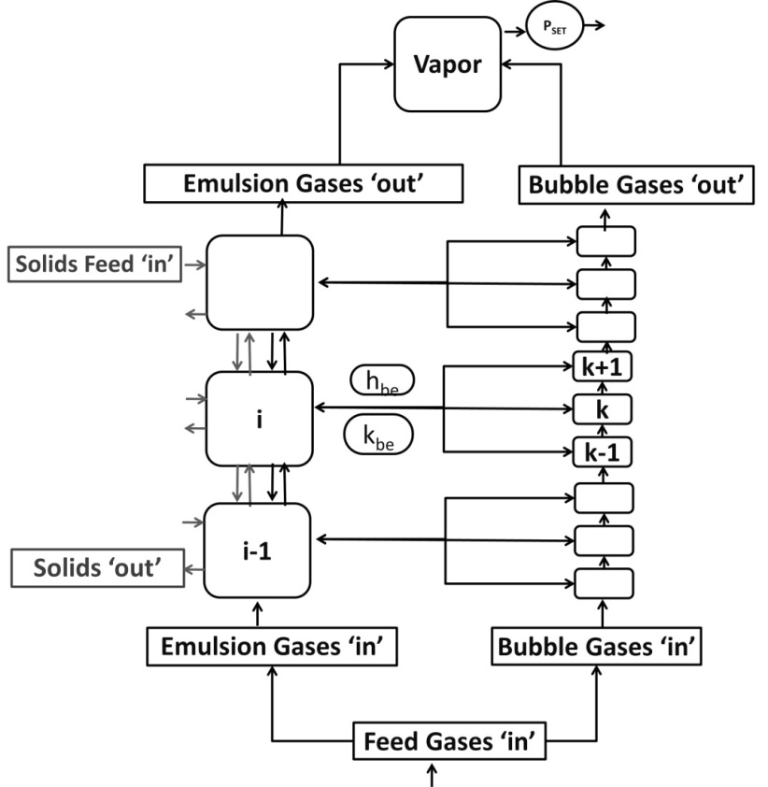
Chemical reaction engineering model
Most models have been based on the two phase theory (1 Dimensional Steady State) wherein
  Emulsion = CSTR or PFR
  Bubble phase = PFR
Mixing cell framework to model BFBG proposed
Advantages of the framework
  Model the non ideality of the bed
  Degree of mixing can be adjusted
  Simulate large operating range of gasifiers
  Different Geometries can be studied
  Feed location , multifeed location studies
  Cogasification , Catalytic effect
Schematic representation of model for BFBG – (Adapted Harshe et al. (2004))
Harshe, Y. M., Utikar, R. P., & Ranade, V. V. (2004). A computational model for predicting particle size distribution and performance of fluidized bed polypropylene reactor. Chemical Engineering Science, 59, 5145–5156.

Slide 23
Species profiles
ode15s solver of MATLABTM used to solve the set of equations with their default tolerance
Typical profiles of emulsion phase
Typical profiles of bubble phase
Oxygen gets consumed within microseconds of entering the reactor

Slide 24
Temperature & hydrodynamic profile
Temperature of solids slightly higher than emulsion gas temperature
Bubble voidage values between 0.52-0.65 (previous reported 0.65)
Diameter of bubble in the range of 0.075-0.1 m
(< 0.5 D )
Temperature profiles of the phases

Slide 25
Comparison of carbon conversion (X)
Parity plot comparing the simulation results of 18 experimental data with Rajmahal coal for carbon conversion
Parity plot comparing the simulation results of 11 experimental data of NK coal for carbon conversion
Carbon conversion over-predicted for Rajmahal coal
Carbon conversion under-predicted for NK coal

Slide 26
Comparison of cold gas efficiency
Parity plot comparing CGE of 18 experimental data sets of Rajmahal Coal with simulation results
Parity plot comparing CGE of 11 experimental data sets of NK Coal with simulation results
CRE shows good match with experimental data compared to thermodynamic model

Slide 27
CRE Model - UCG
One dimensional model – Seam ~ Packed bed
Fuel at inlet - air and steam
Momentum transfer terms and pressure drop – Ergun equation
  Pseudo-homogeneous model; that is rate of change in solid temperature and composition is << gas phase
z

Slide 28




Non-dimensional Model Equations
Gas phase – Mass balance
Momentum
Energy

Slide 29



Solid Phase Equations
Solid – Mass Balance
Energy Balance

Slide 30
Solution Methodology
Solved using finite volume technique
Discretization scheme
  Convective flux - first order upwind scheme
  diffusion - second order approximation
Tri-diagonal matrix algorithm (TDMA) used for solution of linear equations
The program was written in MatlabTM and standard built in TDMA solver was used
  Spatial discretization, time step and tolerances adequately handled

Slide 31
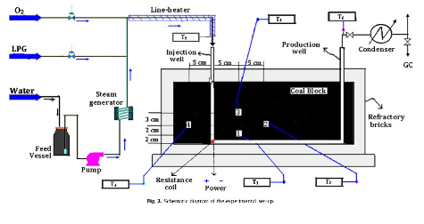
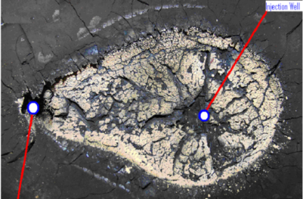
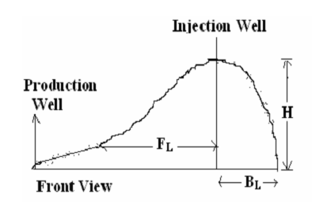
Daggupati (2010)
Experimental Study probing the phenomena of cavity formation in coal block gasification
  Experimental data was available (gas composition) and protocols followed
  Cavity formation studied and discussed in detail

Slide 32
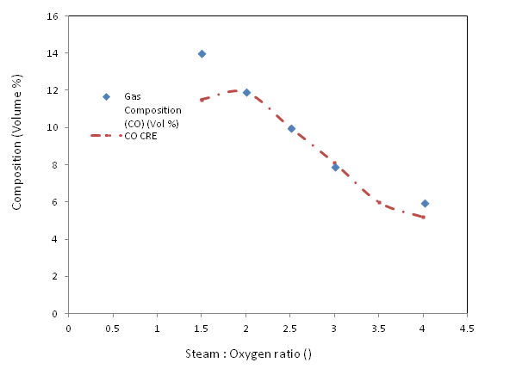
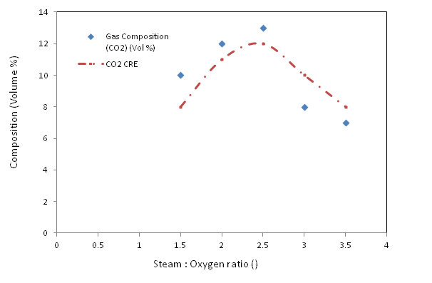
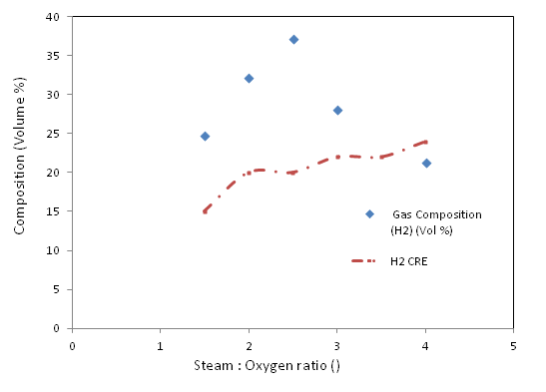
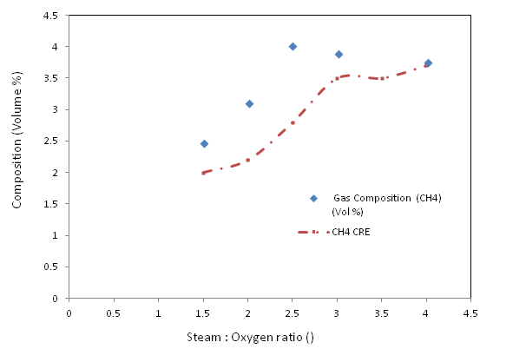
Gas Composition (Daggupati, 2010)
Daggupati, S.; Mandapati, R. N.; Mahajani, S. M.; Ganesh, A.; Mathur, D. K.; Sharma, R. K.; Aghalayam, P. Energy 2010, 35, 2374–2386.

Slide 33
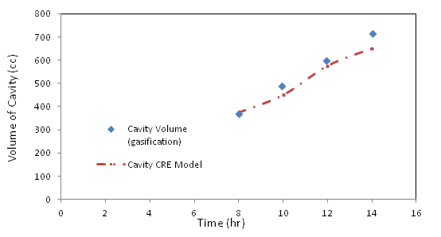
Cavity Volume (Daggupati 2010)
Gasification conditions
Daggupati, S.; Mandapati, R. N.; Mahajani, S. M.; Ganesh, A.; Mathur, D. K.; Sharma, R. K.; Aghalayam, P. Energy 2010, 35, 2374–2386.

Slide 34
Cavity tracking
Cavity volume has been tracked adequately well.
  Study on for identifying the necessary and sufficient parameters that can cover cavity development and reactions – scalable to CFD simulations as well
  Reaction grouping identifies that heterogeneous reactions with Water gas shift (equilibrium controlled) are sufficient to represent the gasification process
Efforts are on to simplify spalling and water diffusion through to the seam and its effect on sudden spurt in cavity size

Slide 35
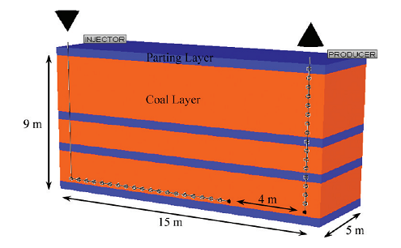
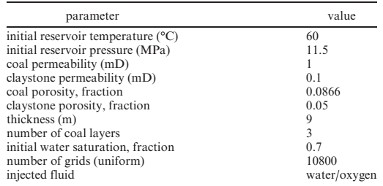
Nourozieh et al. (2010)
CFD simulation study: relatively large scale
  Dimensions 15x9x5 (m)
The field trial data given is not adequate
Nourozieh, H.; Kariznovi, M.; Chen, Z.; Abedi, J. Energy & Fuels 2010, 24, 3540–3550.

Slide 36
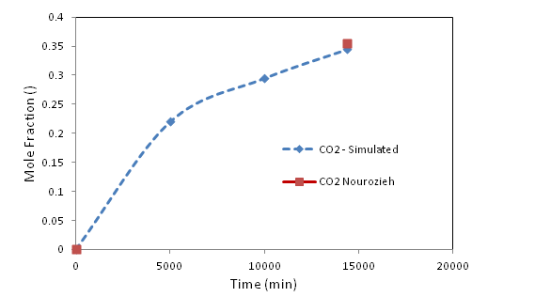
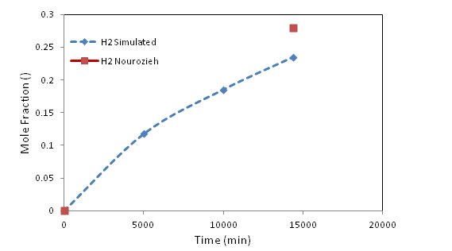
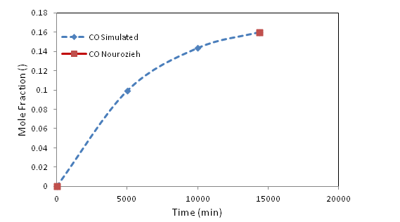
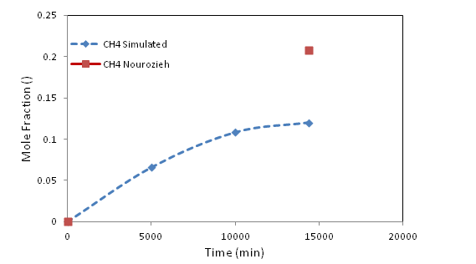
Comparison with Nourozieh (2010)
Comparison of gas at 1:1 feed ratio of steam : Oxygen at Inlet – 1 atm P

Slide 37
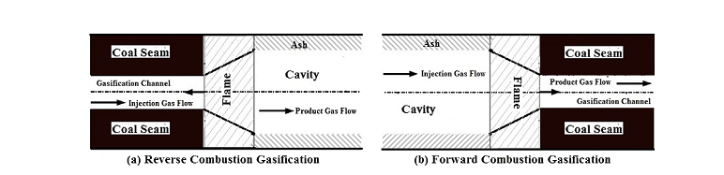
Yong et al. (2014)
Includes forward and reverse combustion gasification processes for optimal resource recovery
  Forward – Seam is monotonously utilized from injection to production well, gas quality goes down with time
  Reverse – Invert the use of production and injection well in cycles to gain more gasification time and utilize the seam – Interesting phenomena occur
Cui, Y.; Liang, J.; Wang, Z.; Zhang, X.; Fan, C.; Liang, D.; Wang, X. Appl. Energy 2014, 131, 9–19.

Slide 38
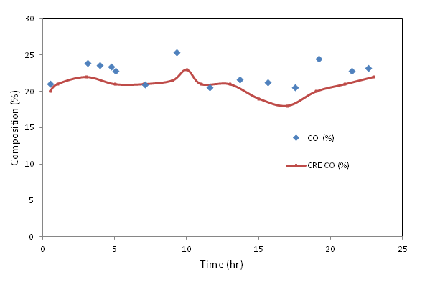
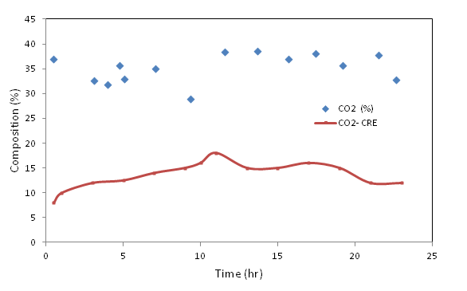
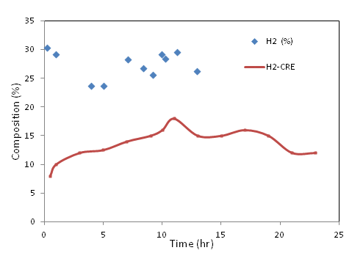
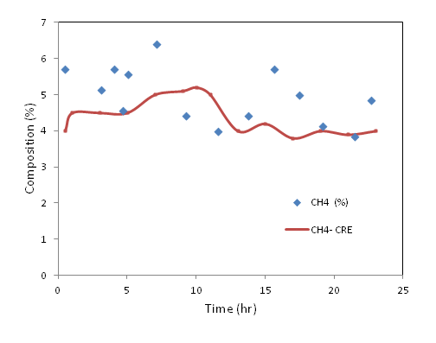
Comparison with Yong et al. (2014)

Slide 39
Outline
Coal gasification
  Indian Coal Scenario
  Gasification – Physical Picture – Overall Comparison – Applications and view of advantages and disadvantages
  Above and below ground systems/ role of computational modelling
Computational models
  Thermodynamic models
  CRE models
  CFD models
Summary and conclusions

Slide 40
CFD Model
Developed CFD models to simulate flow and heat transfer through the porous seam
  Linearization of source terms
  Developed user defined functions for implementing UCG model in FLUENT
  Identified parameter space to be covered
Facing some problems in convergence for large scale field trials
  Need to develop better linearization strategies for sources due to heterogeneous reactions & heat transfer
  Need to develop better models for simulating variation in porosity during gasification
  Large scale field trials require heavy computational power and large quantity of run time

Slide 41
Comparison of Geometry and Features
Feature | Nourozieh et al. (2010) | Daggupati (2011) | Gupta (2012) | Yong (2014)
Geometry
Length (L), cm | 1500 | 30, 34, 46 | 3 | 445
Width (W), cm | 500 | 20, 25 | 2 | 110
Height (H), cm | 900 | 15, 20 | 1.5 | 50
Wells and Channels
Distance between wells (D_{w}), cm | 1500 | 12, 16, 28 | 1.2 | 40
Injection well diameter (D_{i}) SQ, cm | 8.5 | 0.3 | 0.1 | 10
Production well diameter (D_{o}) SQ, cm | 8.5 | 0.3 | 0.1 | 10
Link diameter (D_{L}),SQ cm | NA | 0.3 | 0.1 | 10
Height of clay stone layers (H_{ci}), cm | 50, 50, 50, 50 | (no) | (no) | (no)
Height of coal seam separated by layers (m) | 300,150,200 | - | - | -

Slide 42
Geometry & Boundary Conditions
FRONT VIEW
SIDE VIEW
MASS FLOW INLET (kg/m2s)
INJECTION WELL (ADIABATIC WALL)
PRESSURE OUTLET
PRODUCTION WELL (ADIABATIC WALL)
SIDE WALL (10 W/m2K)
TOP WALL (10 W/m2K)
BACK WALL (10 W/m2K)
FRONT WALL (10 W/m2K)
BOTTOM WALL (10 W/m2K)
BURNER (1500K)
COAL SEAM (300k)
LINK (OPEN)
SYMMETRY PLANE

Slide 43
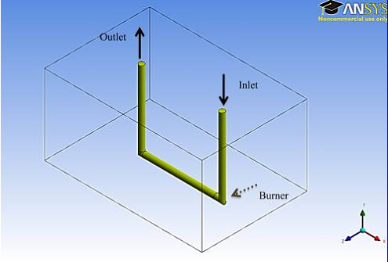
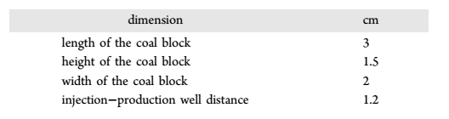
Gupta et al. (2012)
CFD simulation of micro UCG block
Reported simulation carried out using Ansys FluentTM
  Geometry developed and meshed using ICEM-CFD
  UDF’s were written for source terms and the reactions
  Properties calculated using correlations
Shirazi, A. S.; Karimipour, S.; Gupta, R. Ind. Eng. Chem. Res. 2013.

Slide 44
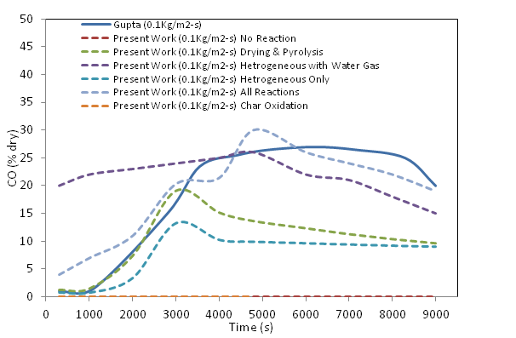
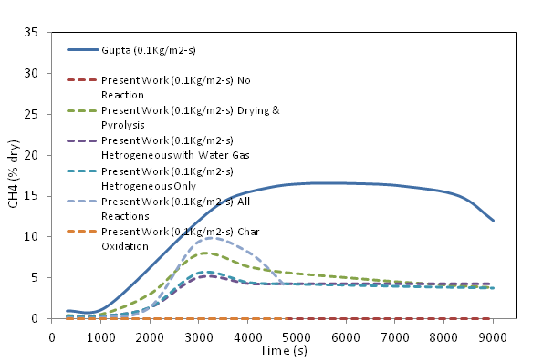
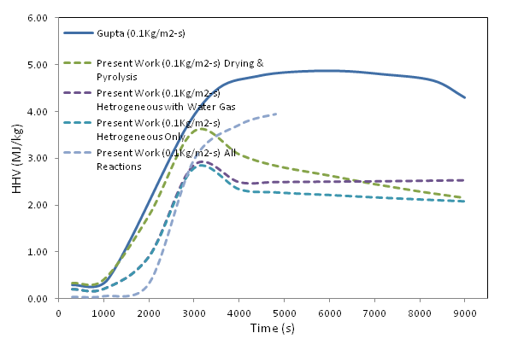
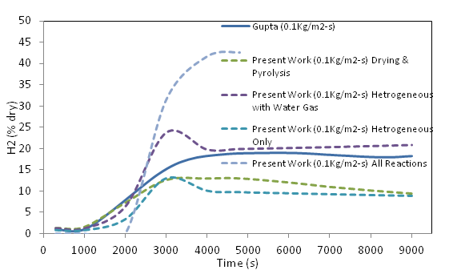
Gas composition – Comparison
HHV

Slide 45
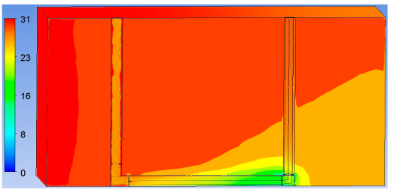
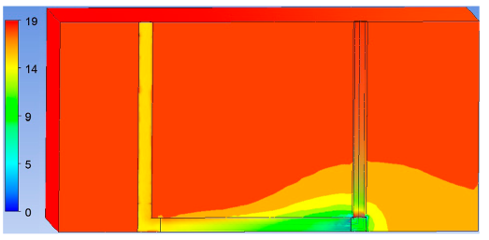
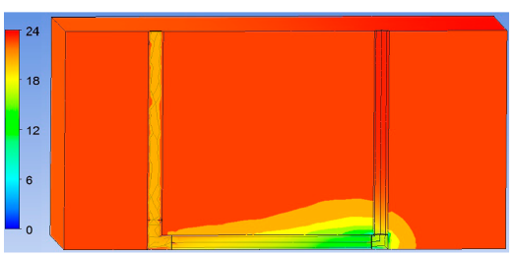

Gas phase Contours
PW
PW
IW
IW
CO Mole Fraction % @ 9000s
CH₄Mole Fraction % @ 9000s
PW
PW
IW
IW
H₂ Mole Fraction % @ 9000s
CO₂ Mole Fraction % @ 9000s

Slide 46


Cavity Temperature and Shape
Temperature Profile
Permeability profile

Slide 47


Cavity Dimensions
Sr. No | Dimension | Gupta | Ergun Equation | Permeability Correlation
1 | Forward Length (cm) | 1.000 | 0.387 | 1.0157
2 | Backward Length (cm) | 0.429 | 0.403 | 0.236
3 | Width (cm) | 0.404* | 0.4827 | 0.160
4 | Height (cm) | 0.399 | 0.451 | 0.1875
5 | Volume (m3) | 1.92E-08 | 9.2321E-08 | 2.76E-08
CRE Model being implemented for other cases also.
Ergun equation
Permeability correlation
Yields clearer shape outline

Slide 48

Daggupati (2010)
Cavity development tracking
  CRE model has covered cavity development adequately
  Experimental cavity formation – data available
  Cavity formation tracking through CFD simulation is challenging
Linearization – Problems in convergence post 4 hours of gasification time
  Trouble shooting is difficult as generalization of error and fix varies on a case to case basis
  Composition and Temperature profile have been compared and show good agreement
  Kinetic parameters show great effect on gas composition
Daggupati, S.; Mandapati, R. N.; Mahajani, S. M.; Ganesh, A.; Mathur, D. K.; Sharma, R. K.; Aghalayam, P. Energy 2010, 35, 2374–2386.

Slide 49




Daggupati – Composition of Syn gas
Daggupati, S.; Mandapati, R. N.; Mahajani, S. M.; Ganesh, A.; Mathur, D. K.; Sharma, R. K.; Aghalayam, P. Energy 2010, 35, 2374–2386.

Slide 50
Summary & Conclusions
Comparison of the Analysis of modeling strategies for both surface and sub-surface gasification discussed
Need for more rigor to simulate complexities that have been lumped/ covered by correlation
Multi-scale analysis need to be fed into simpler models to monitor overall process

Slide 51



Acknowledgements
Prof Anurag Mehra, Chemical Engineering Dept., IIT Bombay
CSIR and MHRD CSIR- GATE Research Fellowship
GAIL - Project Funding
CSIR – Project Funding

