Slide 1




Development of indigenous process model for UCG
UCG
India’s only Energy Company in Fortune’s ‘World’s Most Admired’ List

Slide 2
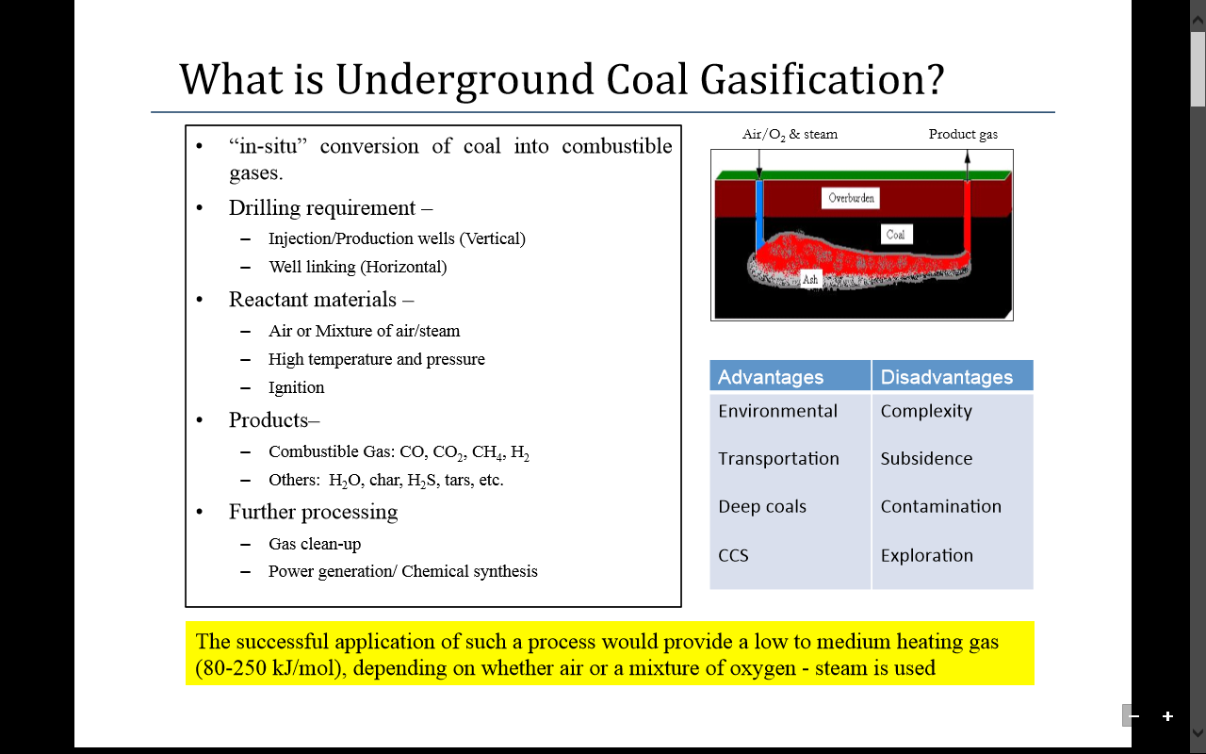
Underground Coal Gasification?
A FORTUNE Global 500 Company

Slide 3
UCG International Scenario
Linc Energy:
At Chinchilla, Australia: Pilot trial since by 2007, total of 5 gasifiers used continued till 2012. Also used enriched air and horizontal wells.
End Usage: Syngas to liquid, 6 Barrels/ day, Aviation fuel Owns UCG commercial station at Angren, Uzbekistan producing @ 1 million M3/d. Syngas for power production.
Carbon Energy:
At Bloodwood Creek, Surat Basin Australia: 100 days trial with Oxygen. Two gasifiers used. Plan submitted for commercial trial.
33 overseas Assets in 16 countries

Slide 4
Contd…
Pakistan:
One Pilot trial carried out at Thar lignite Unsuccessful as per the literature. New pilot with 6 MW planned by next year.
SYNFUELS, Canada:
One trial at 1400 m depth carried out at Alberta. Deepest
ESKOM, South Africa:
UCG Pilot trial continued for 5 years till 2012. Product gas fed to Boiler.
China:
A number of trials have been carried out.
Russia:
Pioneers in UCG. Several large scale projects.
World’s Number 3 Exploration & Production Company : Platts

Slide 5
Potential of Syngas (India)
Coal reserves of India ~ 300 billion tonnes. Large %age deep and un-mineable.
Lignite reserves ~ 40 billion tonnes. ~ 80% un-mineable.
Assuming only about 10 billion tonnes lignite amenable to UCG, potential of production of 2.0 TCM equivalent natural gas using air as oxidant.
In case of 50% enrichment of air with oxygen, calorific value increase by about 30%.
India’s only Energy Company in Fortune’s ‘World’s Most Admired’ List
Notes:
10% of 250 BT=25 BT=25*10 ¹² Kgs=50*10 ¹² m3=50 tcm of syngas= 5.0 tcm equivalent of natural gas
5% of 250 BT=2.5 TCM equivalent of natural gas

Slide 6
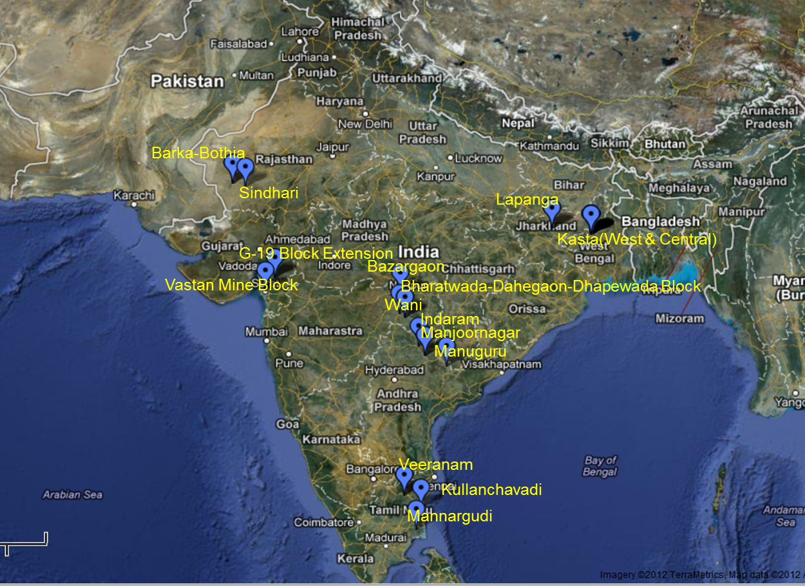
ONGCs UCG venture with NMRC-SIM, Russia
15 sites studied
for suitability for UCG
Vastan prioritized for
UCG pilot
Most valuable Indian PSU

Slide 7
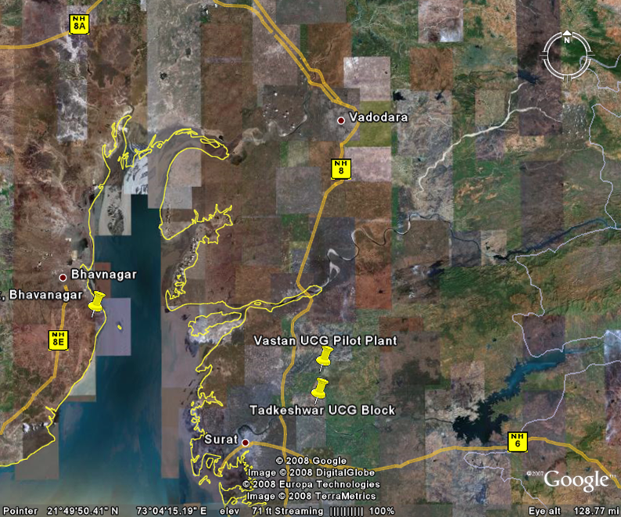
Contd…
A FORTUNE Global 500 Company

Slide 8
Where do we stand today, Vastan ??
Site selection.
Detail site characterization.
Pilot Layout.
Detailed Engineering design.
Environmental clearance obtained in Feb 2010. Renewed till 2020.
Land Acquisition – Land will be taken for 4-5 years on rental basis, GIPCL already negotiated with land owners; waiting for block allocation before initiating proceedings.
On site Preparedness – Requirement for power and water worked up and in pipeline; waiting for block allocation before initiating proceedings.
Pilot execution - Contract to be negotiated.
NIA and Block allocation - Minutes issued by MoC for Vastan Block Allocation (4th August 2014). Allocation awaited.
India’s only Energy Company in Fortune’s ‘World’s Most Admired’ List

Slide 9
Development of indigenous process model in collaboration with IIT-B, Mumbai
World’s Number 3 Exploration & Production Company : Platts

Slide 10
Why do we need indigenous process model?
Project initiated in consultation with NMRC-SIM, Russia.
Indigenous UCG process model not available.
Development of indigenous process model shall allow evaluation of feasibility of the sites for UCG.
Estimation of requirement of input, output etc.
Help in designing commercial schemes for UCG.
ONGC took IIT-B, Mumbai on board for the development of UCG process model.
A FORTUNE Global 500 Company

Slide 11
Black-box Model:
Pre-Reactor | Cavity | Gas-Processor
Type of coal
Coal analysis
Kinetics and spalling using the suggested approach
Inlet gas flow rate, composition, temperature and pressure
Outlet gas flow rate
Gas temperature, pressure and composition
Gas calorific value
Other important outcomes will be number of wells, distance between wells, time for consumption of complete coal, consumption of coal per unit length etc
Most valuable Indian PSU

Slide 12
Output of UCG process modelling
Why do we need a process model?
33 overseas Assets in 16 countries

Slide 13
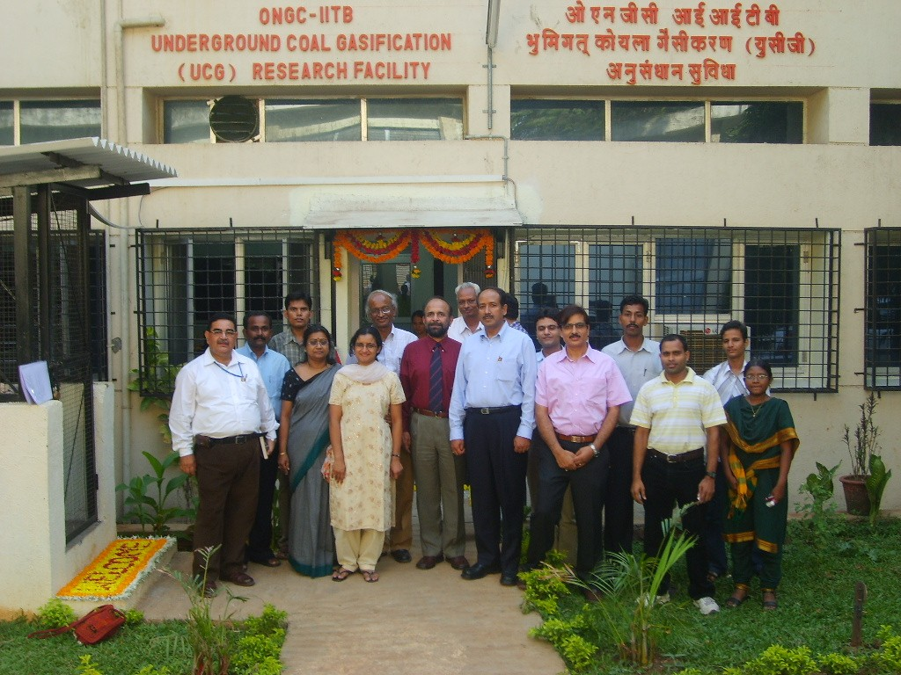
Why do we need a process model?
World’s Number 3 Exploration & Production Company : Platts

Slide 14
Strategy adopted for model development:
Two pronged approach
Development of unique experimental facilities
Development of mathematical model
Raw Process Model
Lab scale experimental validation
Meso scale experimental validation
Pilot scale validation
Highest Dividend-paying Company in India

Slide 15
Conventional equipments:
Proximate and Ultimate analysis
Kinetics through TGA (Pyrolysis and Combustion)
Thermo-gravimetric Analyzer
A FORTUNE Global 500 Company

Slide 16
Micro-UCG:
Highest Dividend-paying Company in India

Slide 17
Cont…
India’s only Energy Company in Fortune’s ‘World’s Most Admired’ List

Slide 18
Cont…
ONGC a Wealth Creator

Slide 19
Cont…
33 overseas Assets in 16 countries

Slide 20
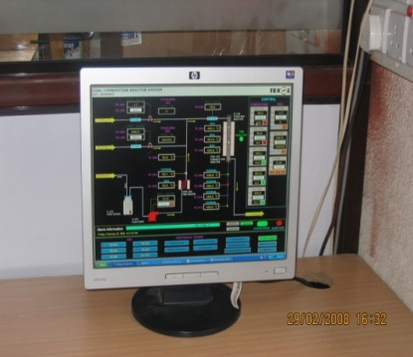
Fixed Bed Reactor:
Most valuable Indian PSU

Slide 21
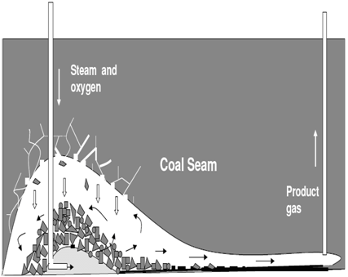
UCG: a closer look
A FORTUNE Global 500 Company

Slide 22
Spalling:
Spalling
What is the rate of spalling?
Most valuable Indian PSU

Slide 23
Patented load Cell for Spalling:
Coal Block is heated only from exposed face to gas flow
Data Logging
Load cell:
Max. capacity:- 15 Kg
Sensitivity:- 1 g
Furnace Lid
Load cell
Thermal Insulation
Coal Block
Coal Block Holder
Outlet
Inlet
Temperature Control
Heater
Wt
EXPERIMENTAL SETUP
Weight of the coal Block is monitored continuously
Highest Dividend-paying Company in India
Time

Slide 24
Evidence of spalling:
Change in weight (g)
Time (min)
Experiment | Rate of Spalling (kg/hr/m2)
Nitrogen | 0.66
Oxygen | 1.14
Air | 1.8
Steam + Oxygen | 2.5
Sudden drops in the weight can be due to spalling.
Δw > 2g can be considered as spalling of larger particles.
Experiments are conducted at different reactive atmospheres at 900 ⁰C.
World’s Number 3 Exploration & Production Company : Platts
Notes:
1.8

Slide 25
Flow Patterns
Cont…
They matter I
A FORTUNE Global 500 Company

Slide 26
Cont…
Highest Dividend-paying Company in India

Slide 27
Cont…
Most valuable Indian PSU

Slide 28
Process Model: going in details..
ash +
char rubble
cavity roof
+
void
Simple and practically usable compartment model
Spalled Char: radial plug flow reactor and void: perfectly mixed reactor
Gas phase consists of 7 species and solid phase consists of 2 species.
33 overseas Assets in 16 countries

Slide 29
Phenomena in UCG: Three levels
Coal Particle
Cavity
Seam
Coal Drying
Cavity size & shape
Coal spalling
Pyrolysis
Flow patterns
Surface Subsidence
Gasification, Combustion, etc.
Growth rate
Heat and mass transport
Water influx
Fundamental Models
Process models
World’s Number 3 Exploration & Production Company : Platts

Slide 30
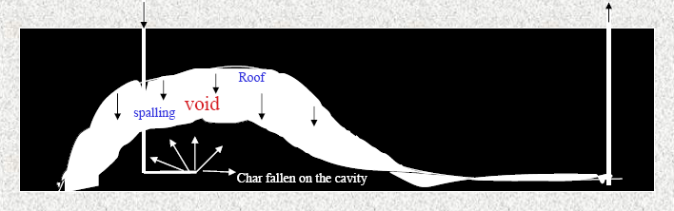
Cavity Model:
Coal on the floor may be modelled as a hemisphere.
Flow takes place uniformly in all directions.
Temp. increases in coal seam as combustion takes proceeds.
Reactions take place on floor and roof of cavity.
Exit gas composition predicted.
Exit gas composition
33 overseas Assets in 16 countries

Slide 31







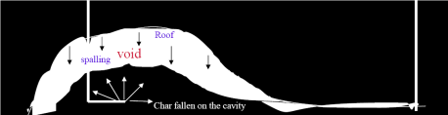
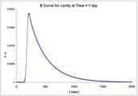
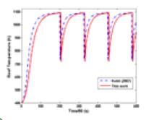
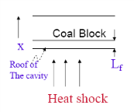
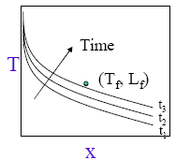
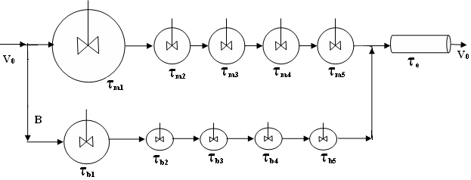

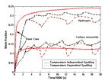
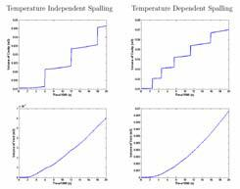
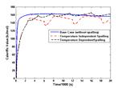


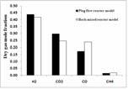
"Thermo-gravimetric and Fixed bed Reactor
Experiments on Gasification, Combustion
and Pyrolysis
"Kinetic modeling
Formulate a model
Determine kinetic parameters
"Fixed bed reactor experiments
Effect of flow rates, particle size etc.
"Determination of mass transfer coefficient
for UCG cavity through experiments
and CFD
Reaction Kinetics
Heat and Mass Transfer
Thermo mechanical Failure
"CFD studies to determine the flow patterns
in UGC cavity
"Experimental validation of the CFD simulations
through tracer experiments
"Compartment modeling based on the above
results
Process Model
Flow Patterns
Development of cracks inside the solid and hence
the detachment of the piece/block of solid from
the main body
The changing geometry of the cavity will influence
the flow patterns and hence the product gas composition
Product Gas Composition / Calorific Value
Cavity Size and Shapes
Packed Bed Model
Cavity Model
Cavity Shapes Experimental
Cavity Volume
A FORTUNE Global 500 Company

Slide 32
Comparison with micro-UCG experiments:
Comparison of predicted gas mole fractions with experimental results at similar conditions.
Simulation with steam/O₂=2.5
[Micro- UCG experiment results from Daggupati et al.(2011)]
Most valuable Indian PSU

Slide 33
More refinement and validation with field trial:
Highest Dividend-paying Company in India

Slide 34


Thank You

